Slide 1
Travel and
Code Playground Application
Presented by :
Nadavaluru Medhasi
Batch WIP-SF-13
LMS Id: 1782288
Date: 27/02/2023

Slide 2
Abstract
Salesforce, Inc. is an American cloud-based software company headquartered in San Francisco, California. It provides customer relationship management (CRM) software and applications focused on sales, customer service, marketing automation, analytics, and application development.
Salesforce's main technologies are tools for customer management. Other products enable customers to create apps, integrate data from other systems, visualize data, and offer training courses.
In here we work on how to Set up the Company Profile, Configuring the user Interface, setting up the search layouts, Configuring Search Settings, Setting up Chatter Groups,Working with validation rules,approval processes and flows.Here we mainly work on Travel Application and Code Playground Application.

Slide 3
Introduction
Salesforce is a cloud-based software company that provides its customers with a platform to develop their own applications without following the tough steps that they used to follow in the legacy system. The software or application once created can be uploaded onto the cloud allowing the end-users to view them.
Salesforce is currently providing various software solutions and platforms for developers to create and distribute custom software/applications. Tech giants like Google, Twitter, Amazon, and Facebook are using Salesforce either in the form of SaaS or PaaS.
Talking about HR systems, every company across the globe has an HR team. Each HR team would require an HR application to store employee records. Almost all specifications for such an application would be common for all companies. So, as a developer, it would be very easy to create a Salesforce application for such specifications, post it onto the cloud, and provide it as a service to multiple clients at the same time. Maintenance of the same can be done altogether too. So basically, the problem of scalability gets eliminated.

Slide 4
Business Requirements
Module 1:
Set up a Lightning app to streamline the travel approval process.
You need to create a custom application that meets these requirements:
Build a Lightning app, add tabs, and customize page layouts.
Create custom objects and fields for the app.
Define relationships between objects.
Import data.
Create Travel Approvals, Travel Expenses & Users.
Customize List views, Page Layouts,Related Lists.
Setup Approval settings for User.
Enable Chatter on the Travel Approval Object.

Slide 5
Module 2:
Add Business logic & Analytics to the Travel Approval App.
You will be adding Business logics, Reports and Dashboards to:
Enforce data integrity with validation rules.
Define business logic using roll-up summary and formula fields
Automate business processes with Flows.
Define Approval Process for Travel Approval App.
Create Reports to analyze Travel Approvals.
Build Dashboards for Travel Approval Management.

Slide 6
Module 3:
Demonstrate your Apex programming skills to:
Write and execute codes from Anonymous window.
Demonstrate the use of Data types & Variables.
Demonstrate the use of Control Flow Statement.
Define relationships between objects. Data Manipulation using DML.
Querying the Database using SOQL.
Create Apex Classes, Objects & Interfaces
Write Apex Triggers
Write Test Classes.
Create VisualForce Pages.

Slide 7
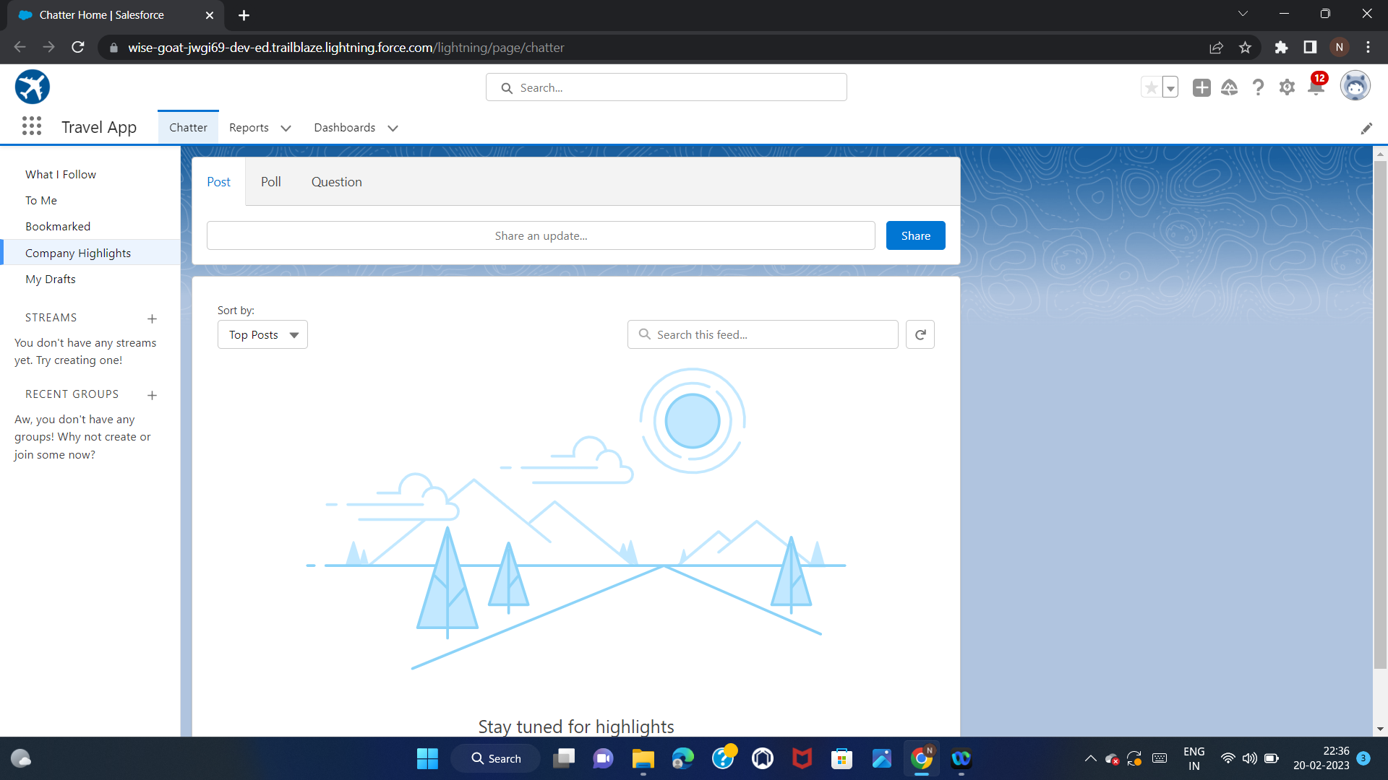
Screenshots
Module 1
Exercise 1:
Step 1:
Create a new custom lightning App, name: Travel App.
Upload Travel.png as App image, Keep “Org Theme options” checked.
Navigation Style=”Standard Navigation”,leave rest as it is.
Select and add Chatter,Reports and dashboards to the Navigation items.
User Profile=”System Administrator”
Save and Finish

Slide 8
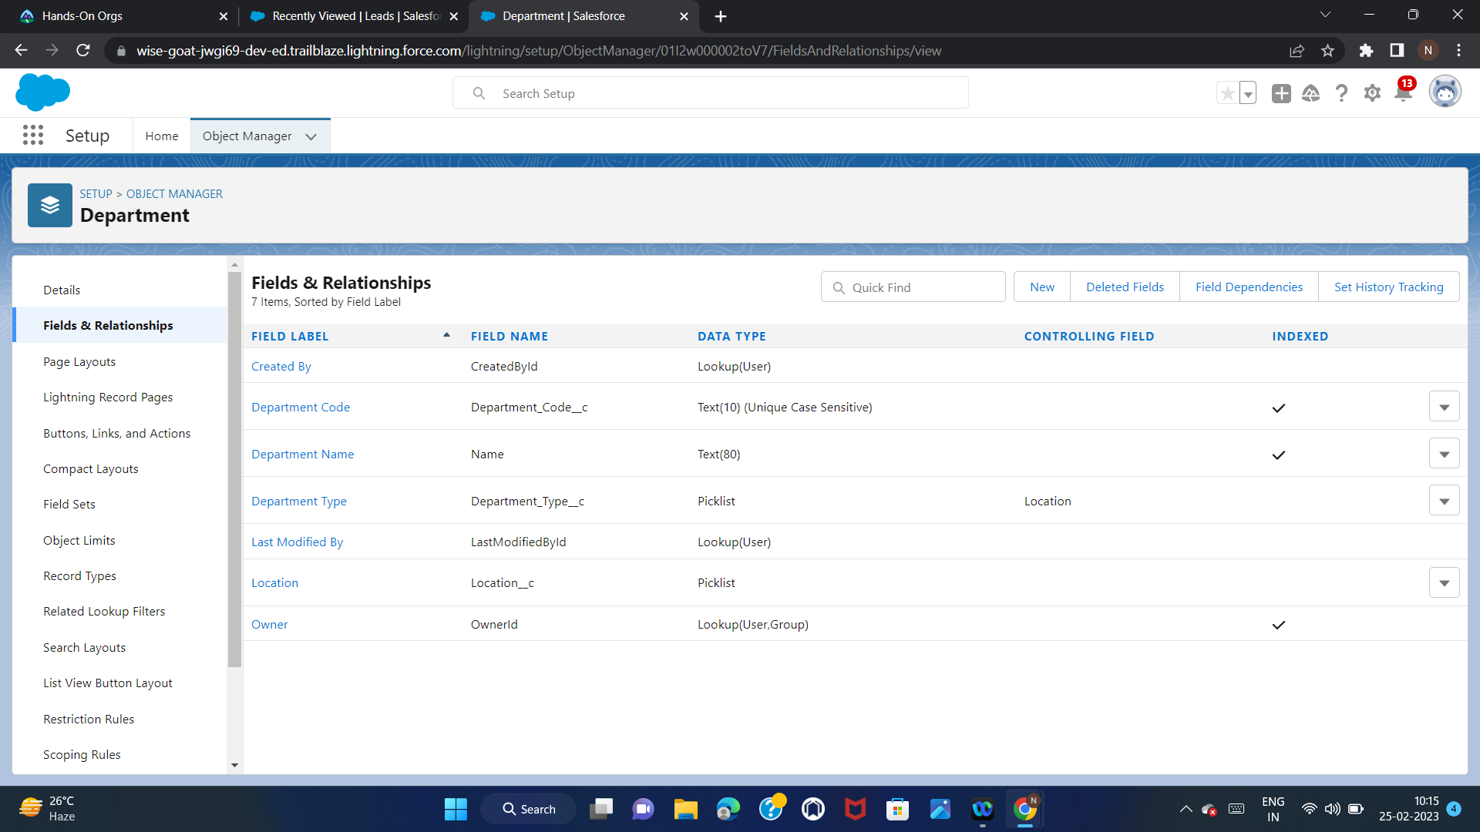
Step 2:
Create a Department custom object
Label=”Department”
Plural=”Departments”
Data type=”text”
Select “Allow Reports”,”Allow Search”
Keep other options as it is
Use custom tab and include it only for Travel App
Tab visibility=As it is,Save
Step 3:
Create the following custom fields:
1.Department Code,Text ,length=10,Required,Select Unique and Case sensitive
2.Location,Picklist, Values:Kolkata,Delhi
3.Department Type,Picklist,Values:Banking,Finance,Education,Energy,IT

Slide 9
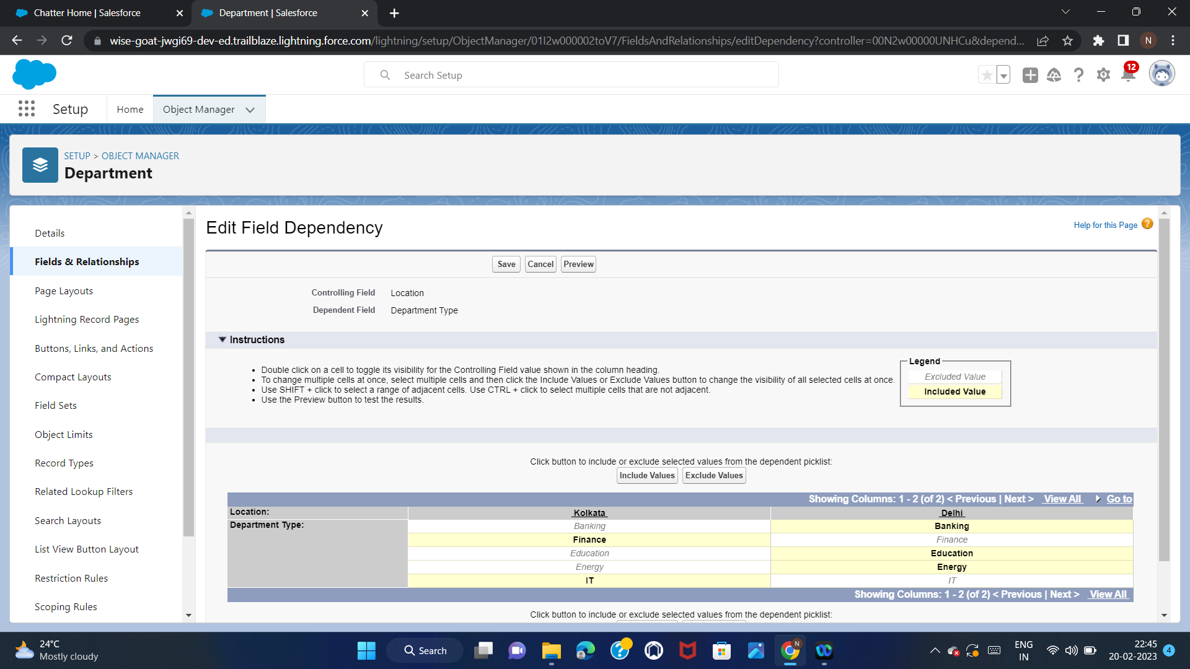
Create Field Dependency
Controlling field=Location,
Dependent field=Department Type

Slide 10
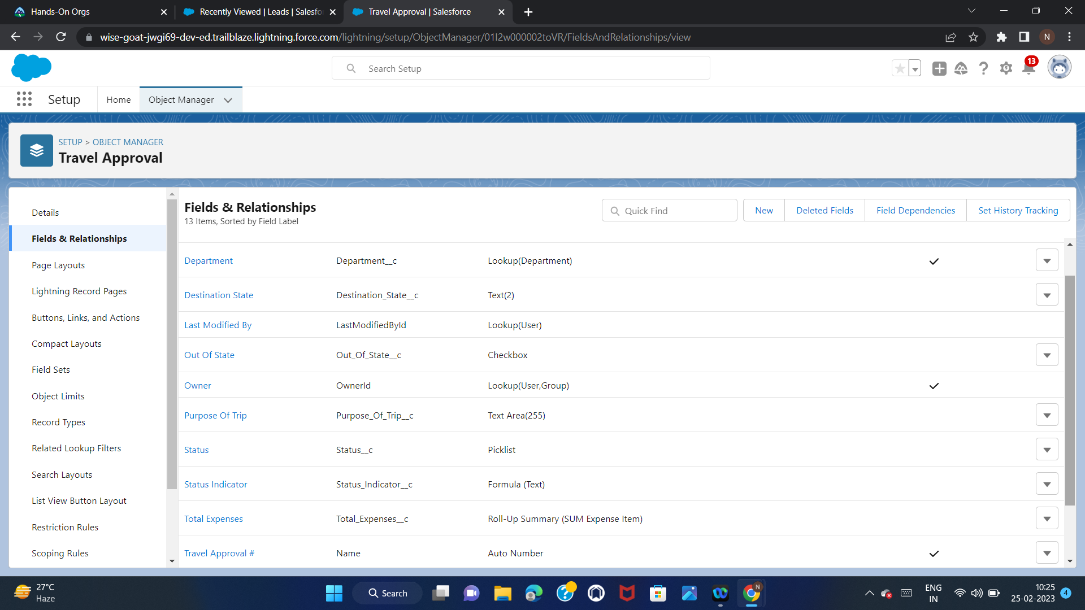
Step 4
Create a Travel Approval Object.
Label=”Travel Approval”
Plural=”Travel Approvals”
Object Name=”Travel_Approval”
Record Name=”Travel Approval #”
Data Type=”Auto Number”
Display format “TA{00000}”
Starting Number=1
Allow Reports
Allow Activities
Track Field History
Allow Search
Add Notes and Attachments
Create a custom tab
Add the tab only to Travel App,Save

Slide 11
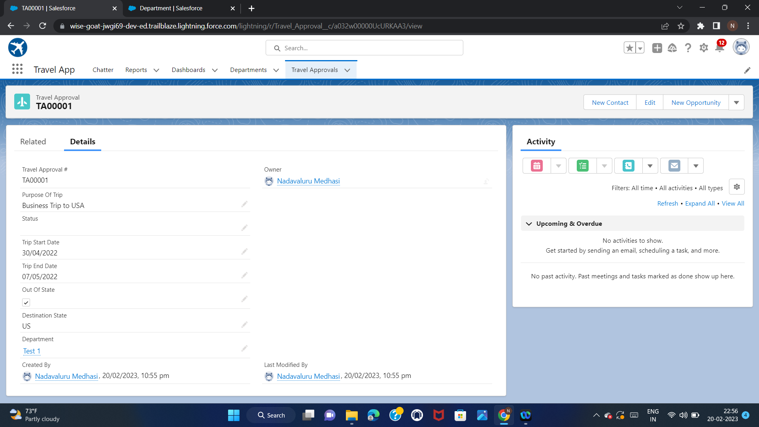
Create the Custom fields:
1.Purpose Of Trip,Text Area
2.Status,Picklist,
Values=New,Submitted,Pending,Approval,Approved,Rejected,Draft
3.Trip Start Date,Date
4.Trip End Date,Date
5.Out Of State,Checkbox
6.Destination State,Text,Length=2
7.Department,Lookup,Related To=Department custom object

Slide 12
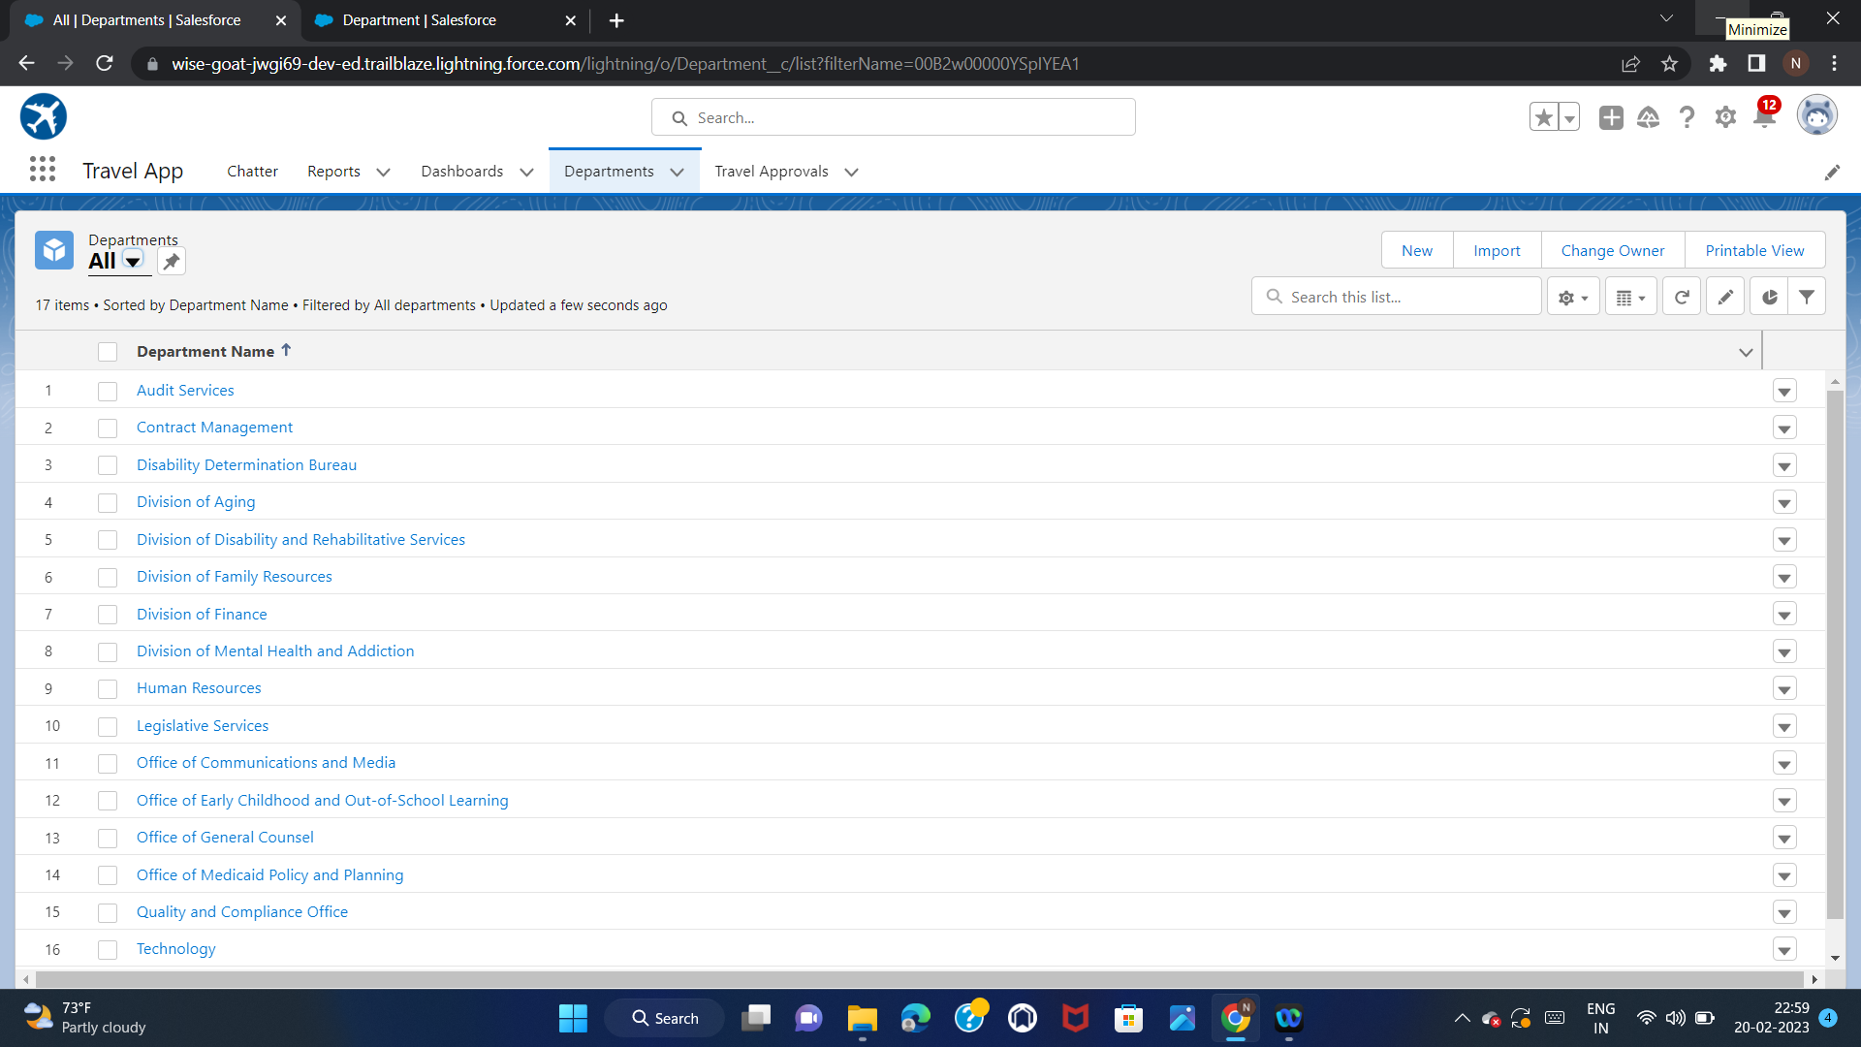
Step 5
Import Departments
Download the Department.CSV File
Open “Data Import Wizard”,Click “Launch Wizard”
Select “Departments” custom object
Add new records ,upload the file by clicking the csv icon
Map the fields,click Next
Start Import
Make sure all the records are inserted.

Slide 13
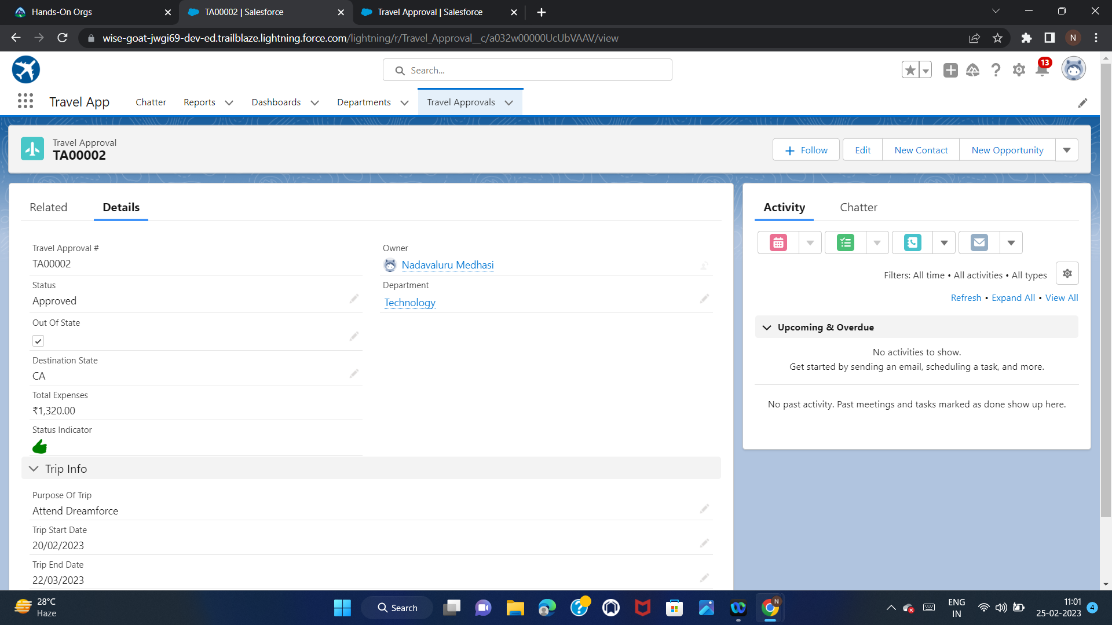
Exercise 2
Step 1:
Create a Travel Approval record.
Purpose of Trip=”Attend Dreamforce”
Status=”Draft”
Trip Start Date/End Date=”Pick any Date”
Out Of State=True
Destination State=”CA”
Department=Technology,Save

Slide 14
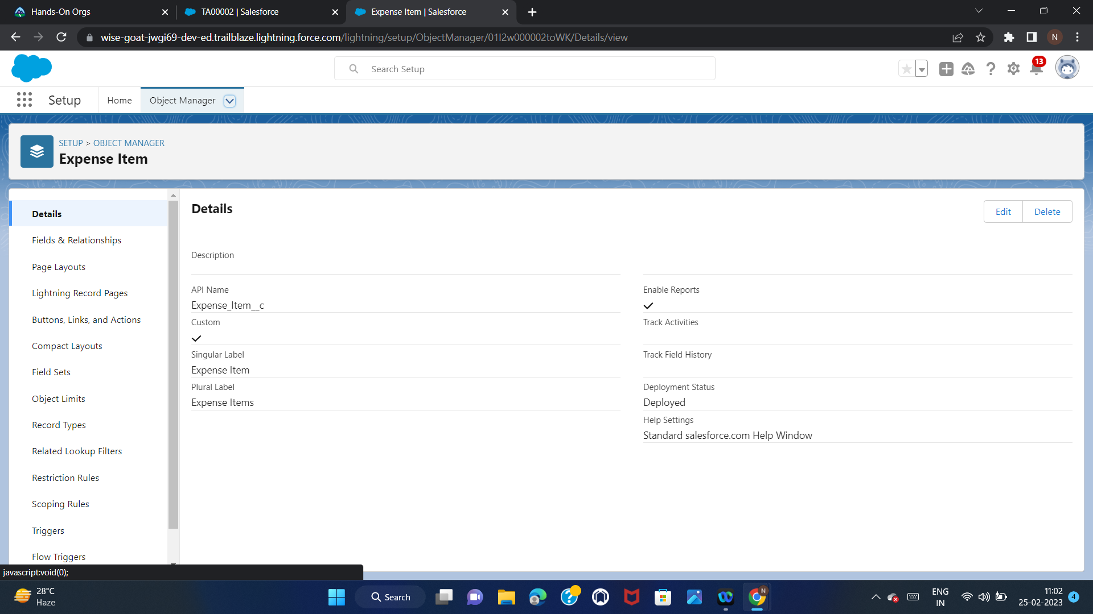
Step 2:
Create Expense Item Object.
Label=”Expense Item”,Plural=”Expense Items”
Starts with vowel sound=Checked
Record Name=Expense Item Number,Data Type=Auto Number,
Display format=E-{00000}
Allow Reports,Do not create Custom Tab,Save

Slide 15
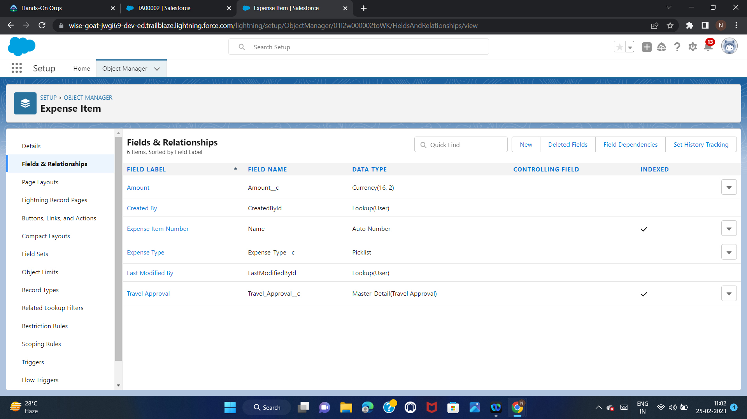
Step 3:
Create the following custom fields:
1.Amount,length=16,Type=Currency,Decimal=2,Required=True
2.Expense Type,Type=Picklist,
Values=Airfare,Hotel,Rental Car,Meals,Other,Required=true
3.Travel Approval,Type=Master-Detail,Related To-Travel Approval

Slide 16
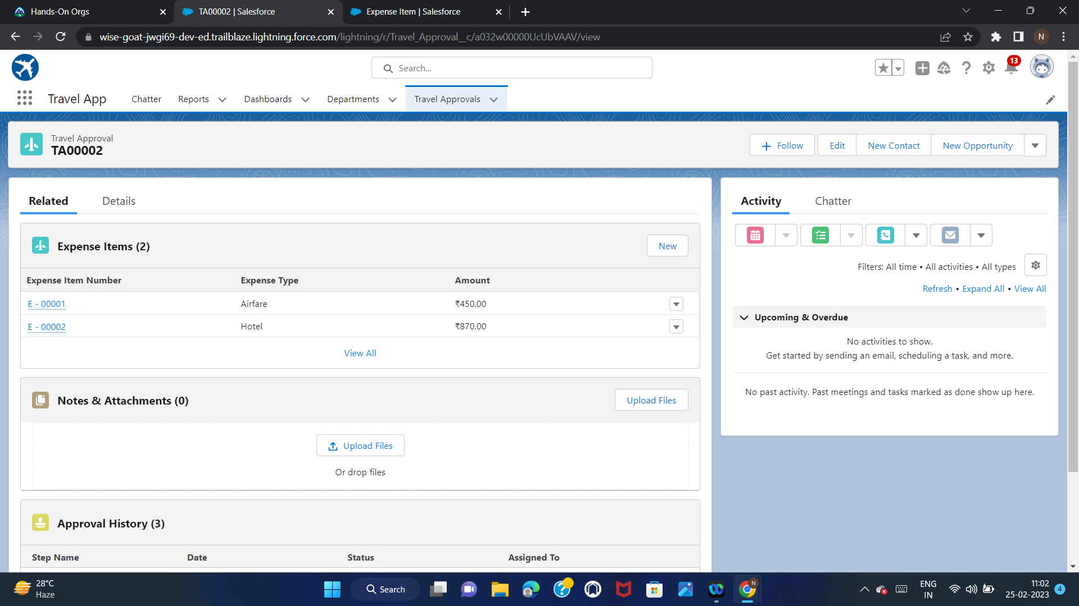
Step 4
Create Expense Items.
Amount=450,Expense Type=”Airfare”
Save.
Amount=870,Expense Type=”Hotel”
Save

Slide 17
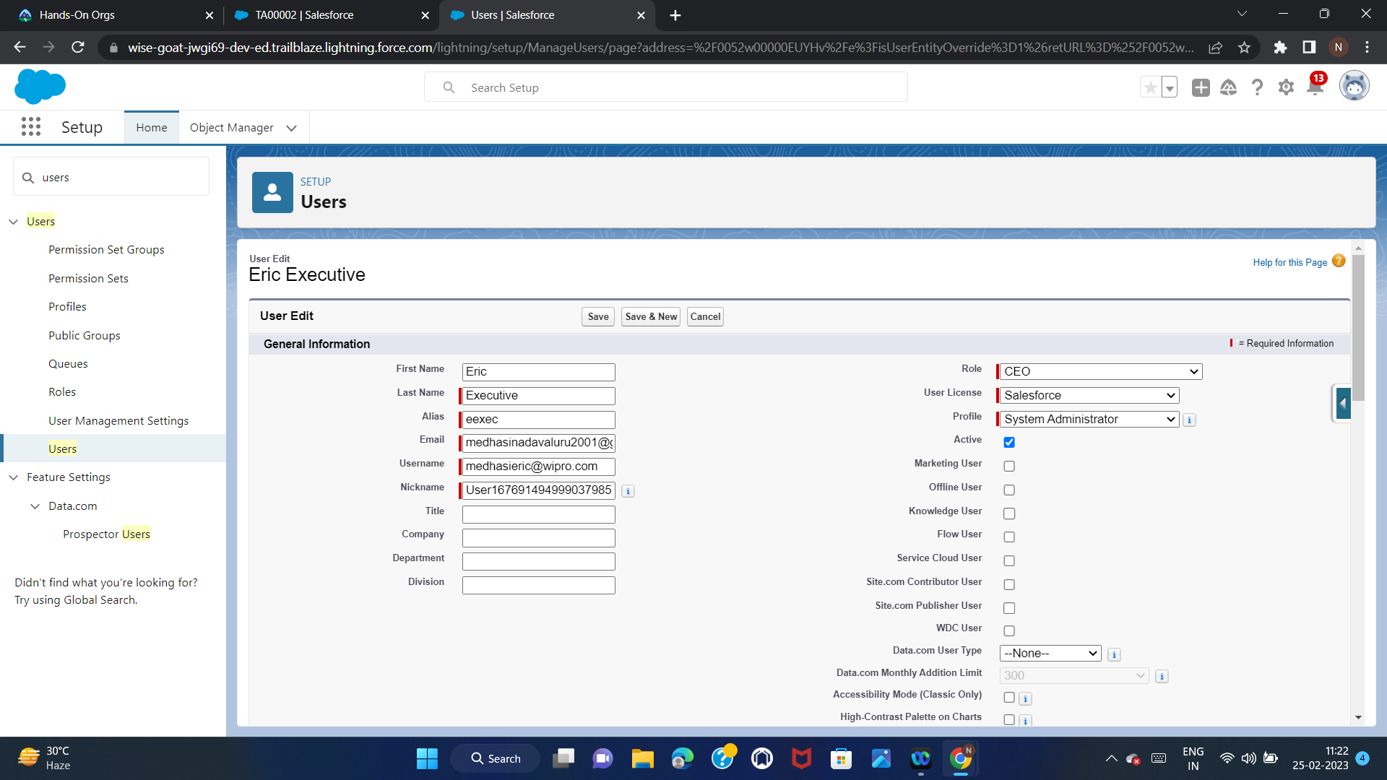
Step 5:
Create a User
First Name=”Eric”,Last Name=”Executive”,Email=”Use your own email”
UserName=”Choose a Unique username”
Role=”CEO”
License=Salesforce
Profile=System Administrator
Save

Slide 18
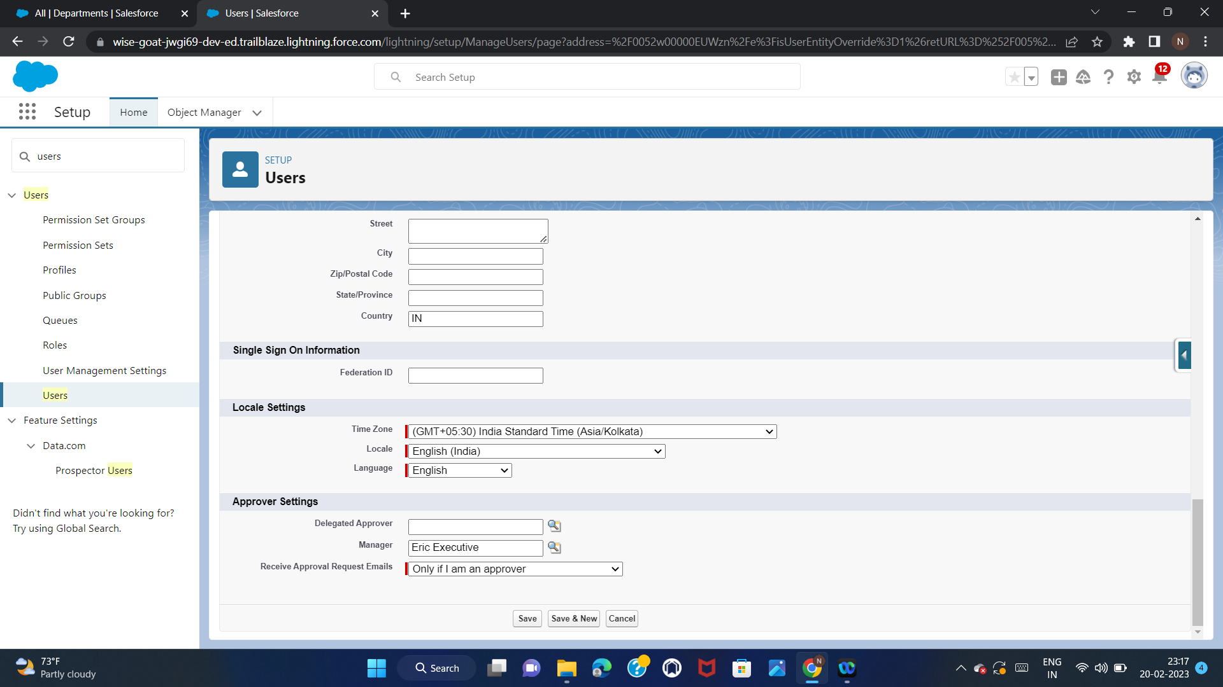
Step 6:
Add user Eric Executive as your manager.

Slide 19
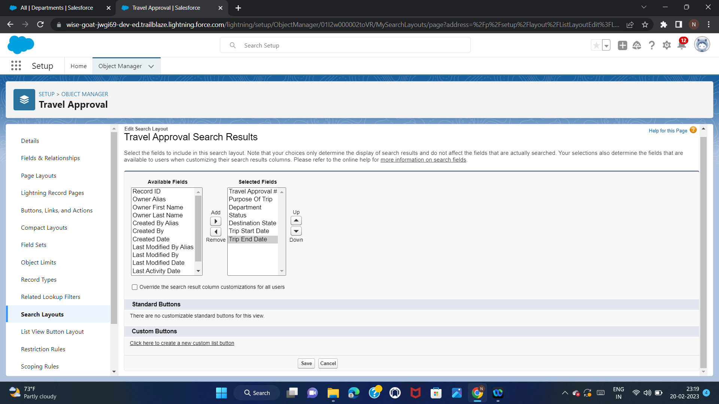
Step 7
Customize the Travel Approval default search layout as shown in the screenshot.

Slide 20
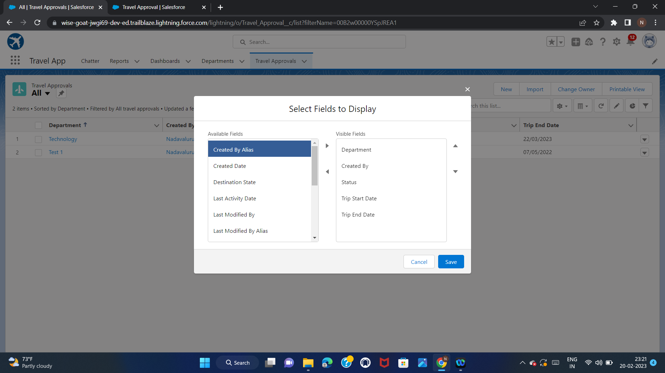
Step 8
Select fields to display in the Travel Approval “All” List view as shown in the screenshot.

Slide 21
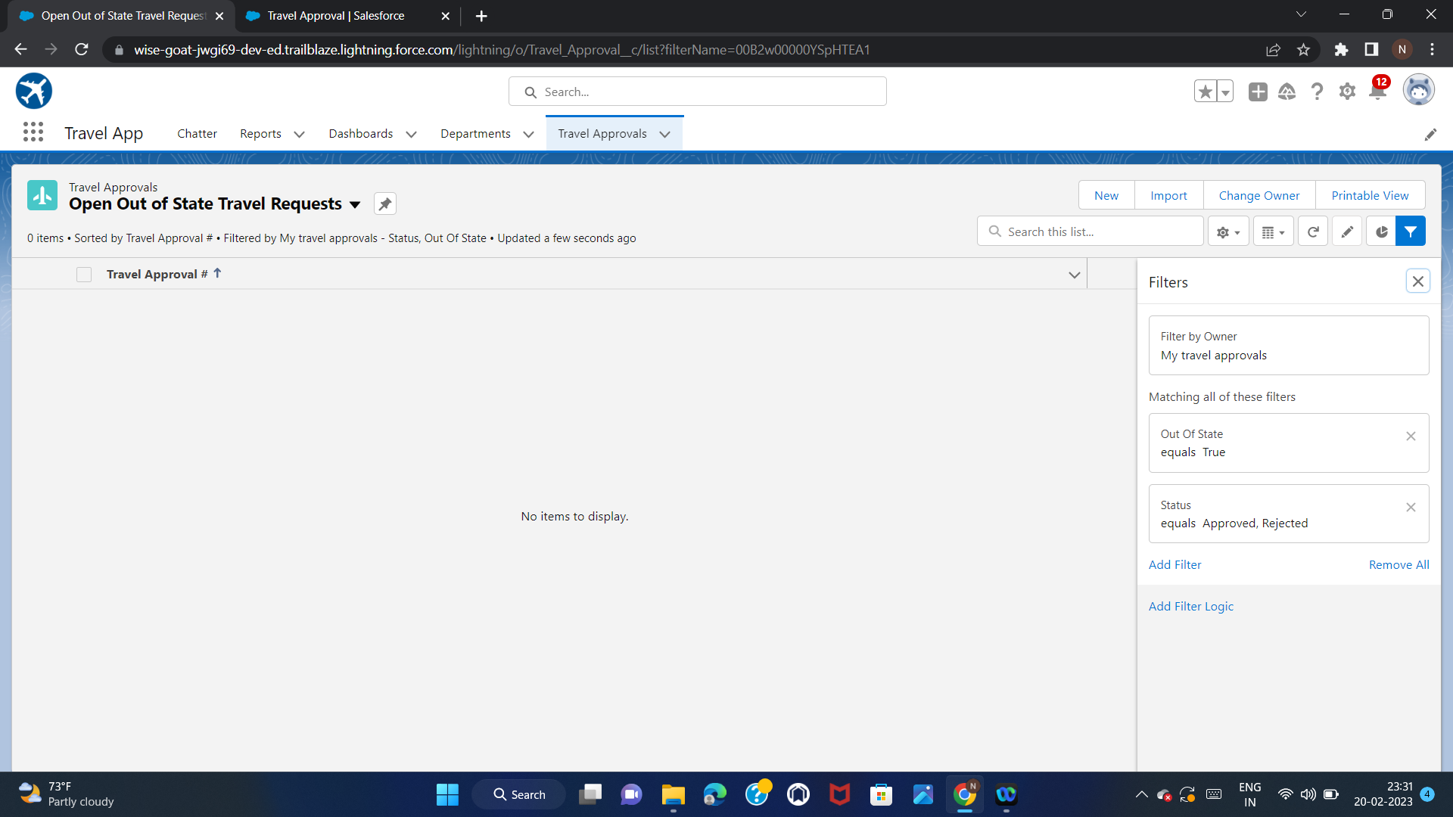
Step 9:
Create Travel Approval custom List View “Open Out of State Travel Requests”
All users should be able to see this list view

Slide 22
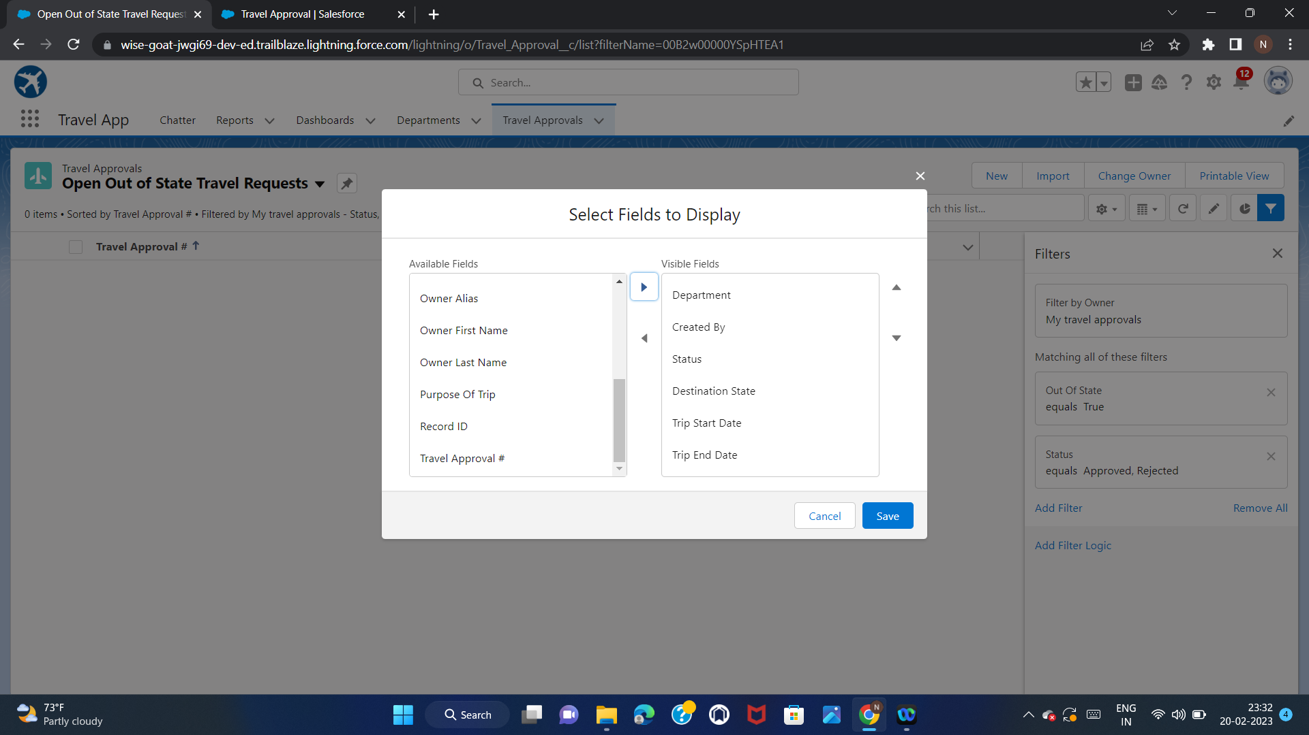
Step 10:
Select fields to display in the Travel Approval “Open Out of State Travel Requests” List view as shown in screenshot and save

Slide 23
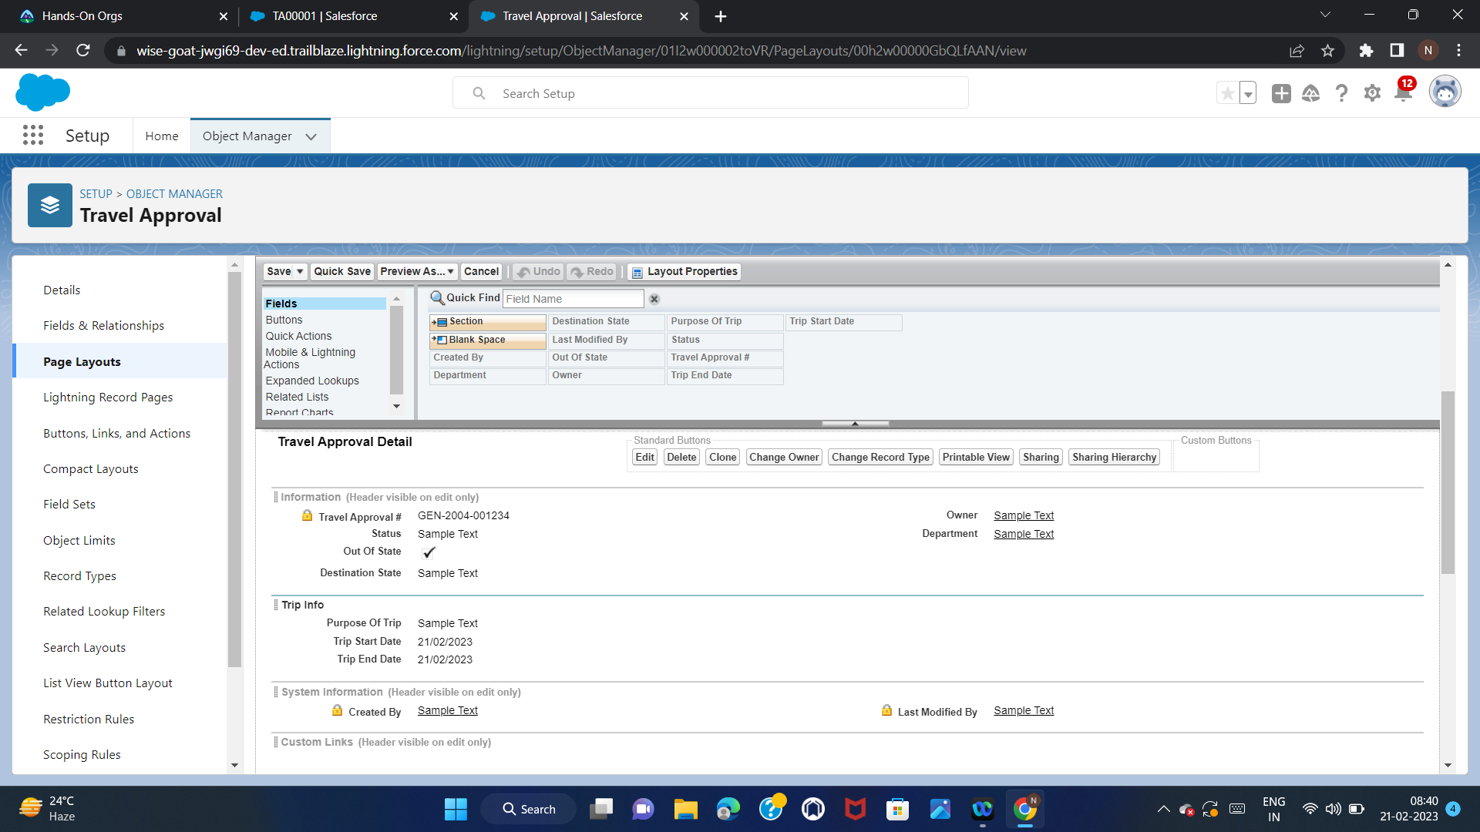
Step 11:
Customize the Travel Approval Page layout.
1.In the Travel App app,click the Travel Approvals tab and open TA-00001
2.Click Setup and then select Edit Page
3.Left click once in the middle of the form to select it.you should see a light blue border around the form.
4.On the right-hand side,Click Travel Approval Layout(previewed)
5.Scroll down to the Travel Approval Detail section.Here’s where you can change the order and position of the fields.
6.Add a section to the page layout called “Trip Info” and add the fields as shown in the screenshot.

Slide 24
Step 12:
Edit the Expense Item Related List
Related lists can be added to any salesforce page they are related or linked to.
1.From Page Layouts in the Object Manager,Select Travel Approval Layout.Scroll down to the Expense Items related list.click the wrench icon in the header tab.
2.Move the Expense Type and Amount fields from Available fields to Selected
fields.
3.Clock OK.Click Yes if you are asked if you want to Overwrite Users Related Lists Customizations.
4.Click Save.
5.Navigate back to a Travel Approval Record and look at the related lists.you should see the extra columns you added to the expense item related lists.

Slide 25
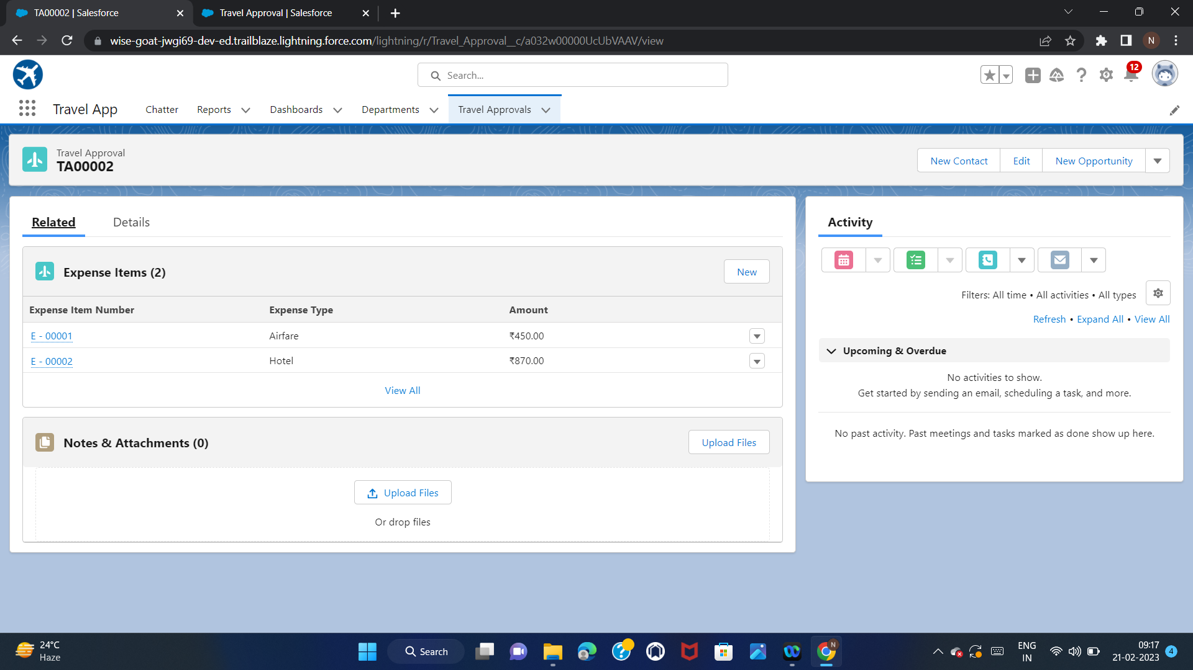

Slide 26
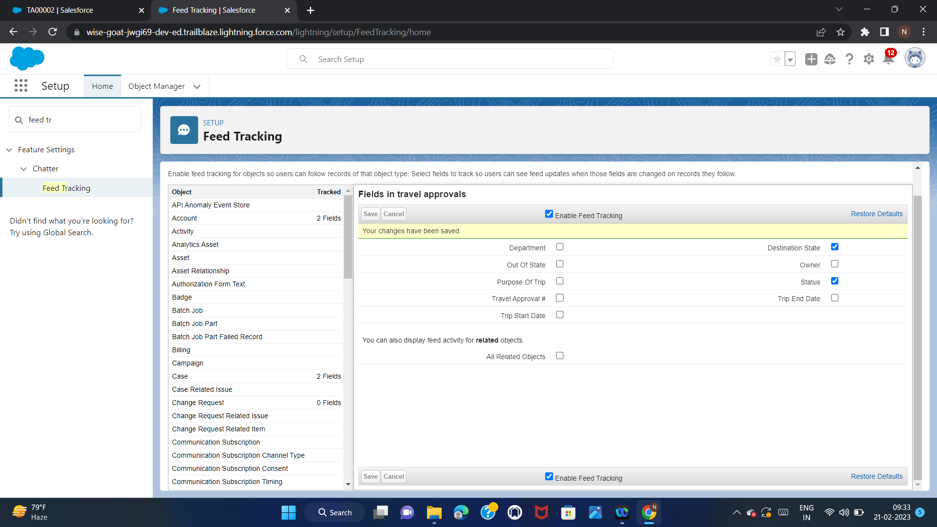
Step 13:
Enable Chatter on the Travel Approval Object.
Enable “Feed Tracking” for Travel Approval Object.
Select these 2 fields:Destination State,Status and then save.

Slide 27
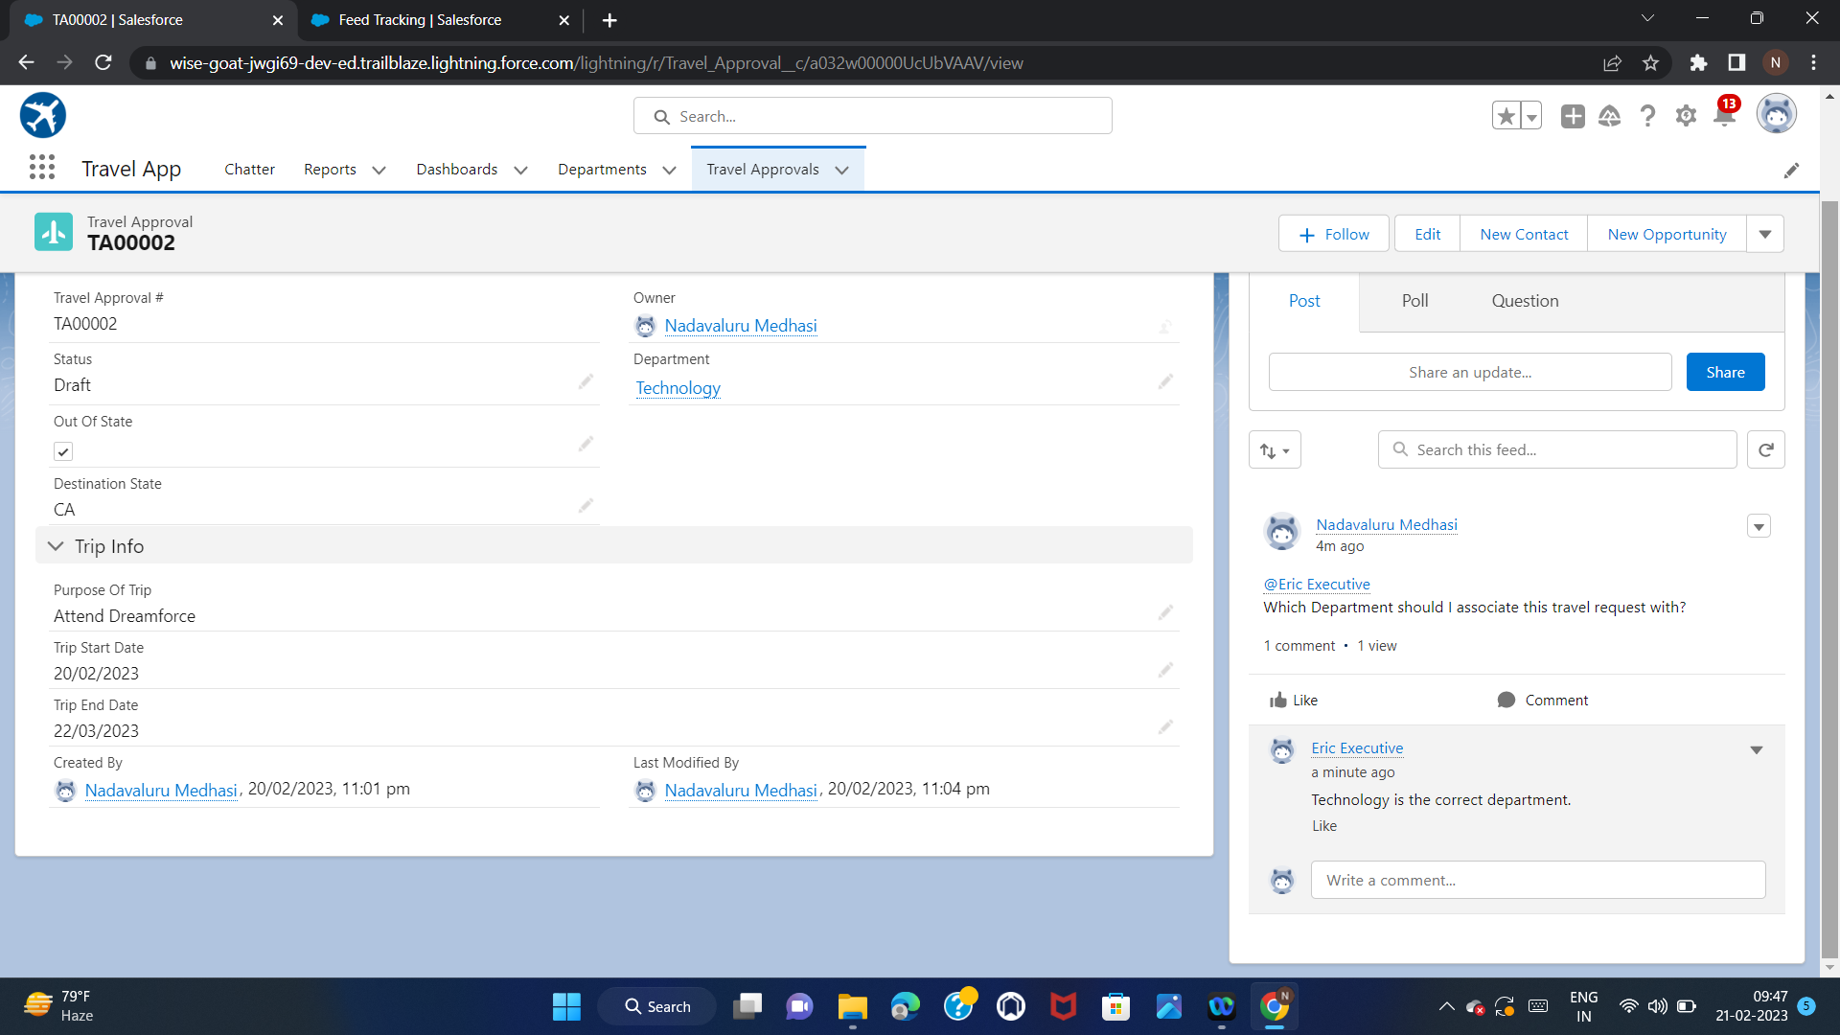
Open a Travel Approval record
Click on Chatter Tab
Share a Post:Which Department should I associate this travel request with?
Mention user Eric Executive on the post using @.
Login as Eric and reply to the email,saying:”Technology is the correct department”
Enable Administrator can log in as any user.

Slide 28
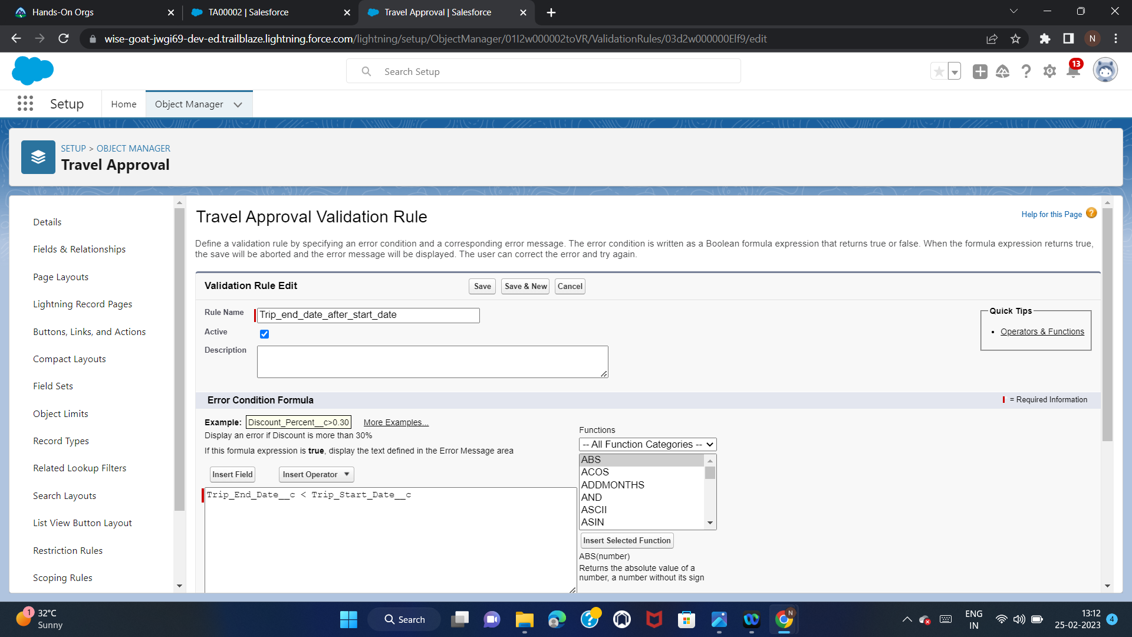
Module 2
Exercise 1
Step 1:
Create a Validation Rule for Travel Approval Object
Business Logic: Trip end date must always be greater than(>=) the trip start date
Name:Trip end date after start date
Make sure to keep “Active” selected/checked
Error Message:Trip end date must be greater than or equal to start date
Error Location:Select field and pick Trip End Date as the location for the error

Slide 29
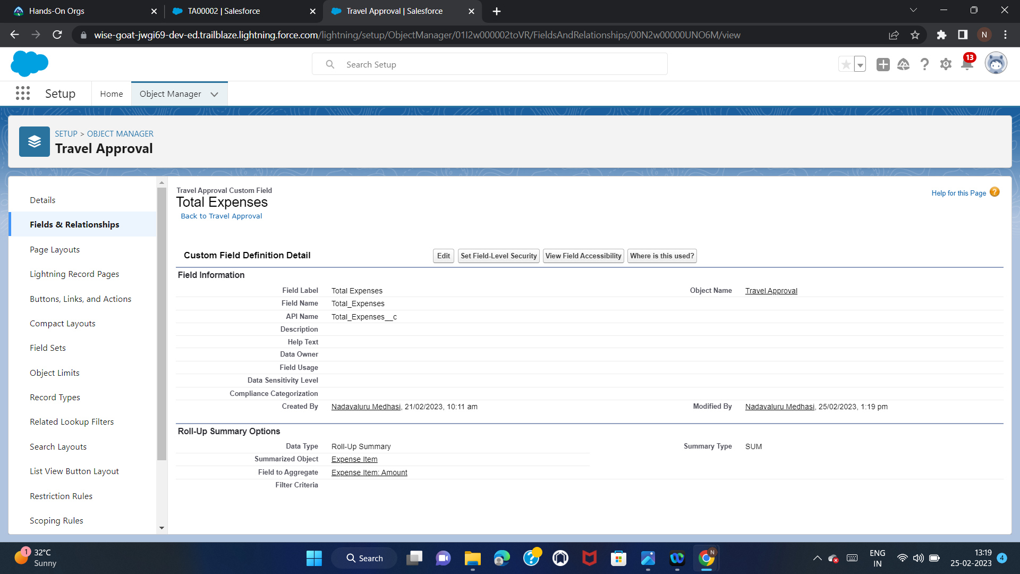
Step 2:
Create a Roll-Up Summary field on Travel Approval object
Business Logic:Automatically sum of the total amount of expenses from the
related Expense Item
Field Label:Total Expenses
Field Name:Total_Expenses
Roll-Up Type:Sum
Field to Aggregate:Amount
Filter Criteria:All records should be included in the calculation
Save

Slide 30
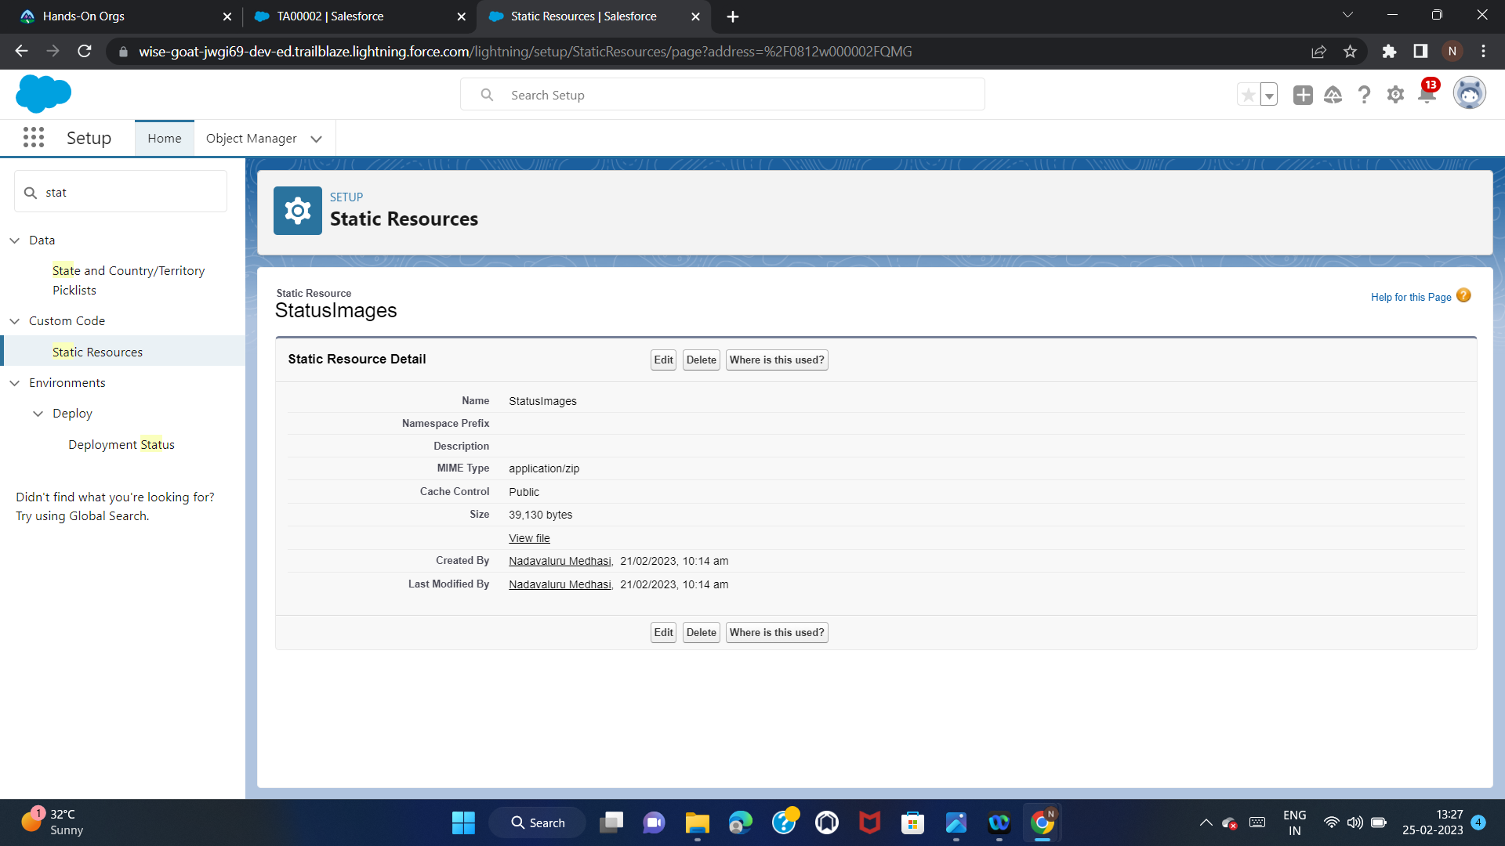
Step 3:
Create Formula Fields
Business Logic:Create a field that shows visual indicator based on the value of the
Status field
Click Setup select Custom Code | Static Resource | New
Name=StatusImages
File=StatusImages.zip(upload it from the project folder)
Cache-Control=Public
Save

Slide 31
Step 4:
Create a Formula field on the Travel Approval object to show an image based on the status field.
Field Label:Status Indicator
Formula Return Type:Text
Copy & Paste the formula: IF( ISPICKVAL( Status c , 'Approved') , IMAGE("/resource/StatusImages/thumbs-up.png", "Accepted", 20, 20),
IF ( ISPICKVAL( Status c , 'Rejected'), IMAGE("/resource/StatusImages/thumbs-down.png", "Rejected", 20, 20),
IMAGE("/resource/StatusImages/draft.png", "In-Process", 20, 20)))
Save

Slide 32
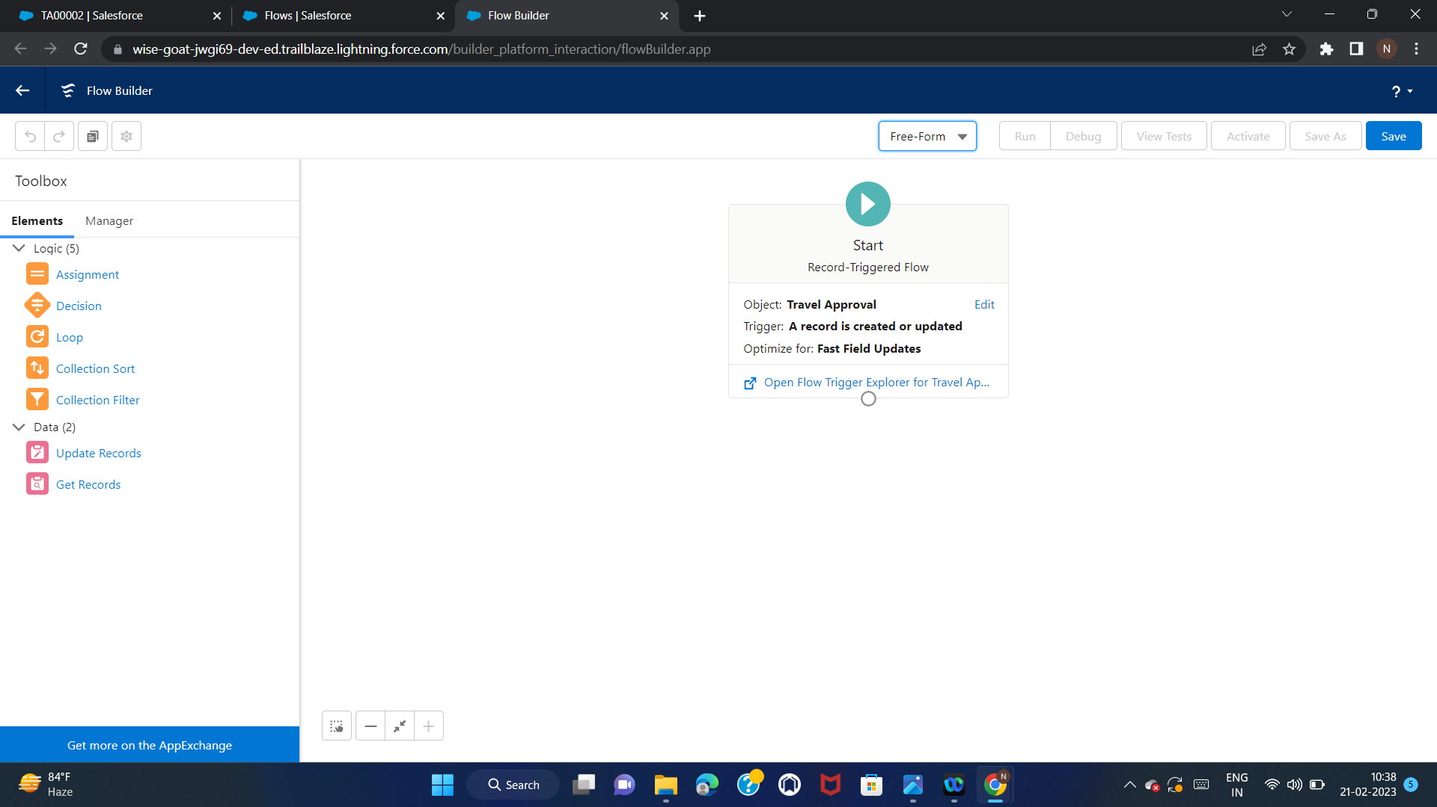
Step 5:
Create a Record – Triggered Flow.
Set the Out-of-State checkbox field on the Travel Approval object if out-of-state travel has been chosen.
Object: Travel Approval.
Configure Trigger: Trigger the flow when: A record is created or updated.
Condition Requirements = None.
Optimize the Flow For: Fast Field Updates.
Done.
Select “Freeform”.

Slide 33
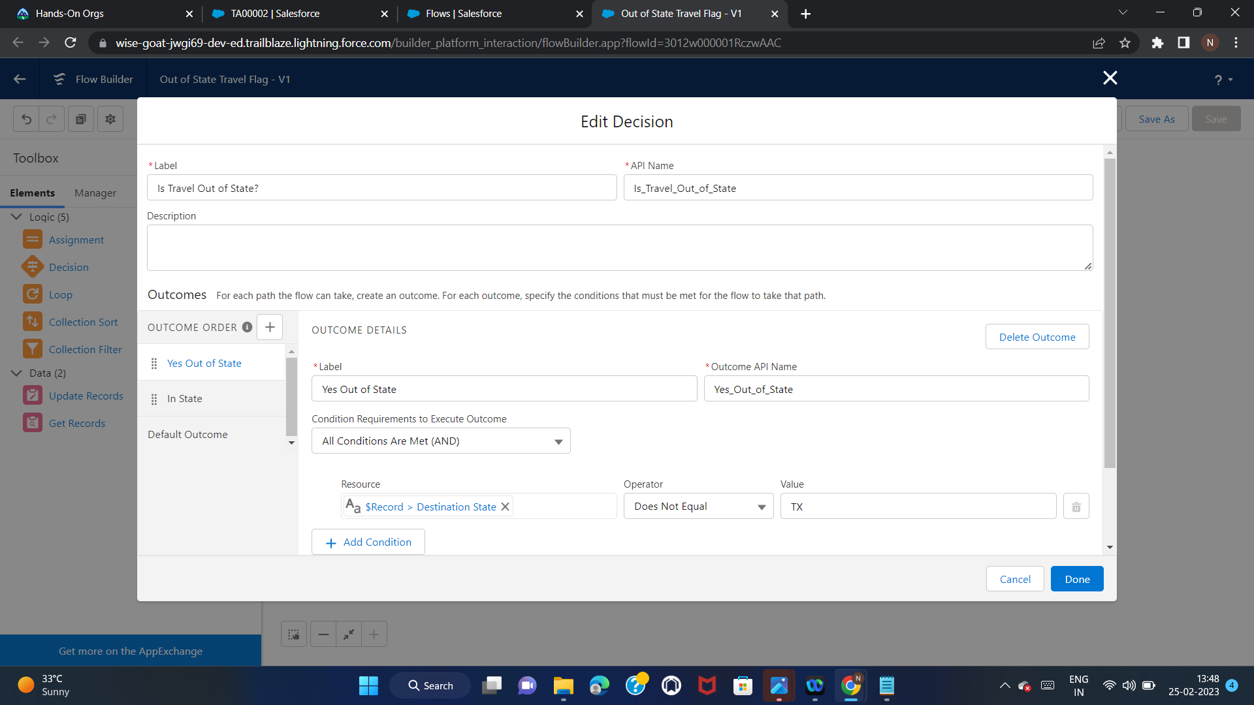
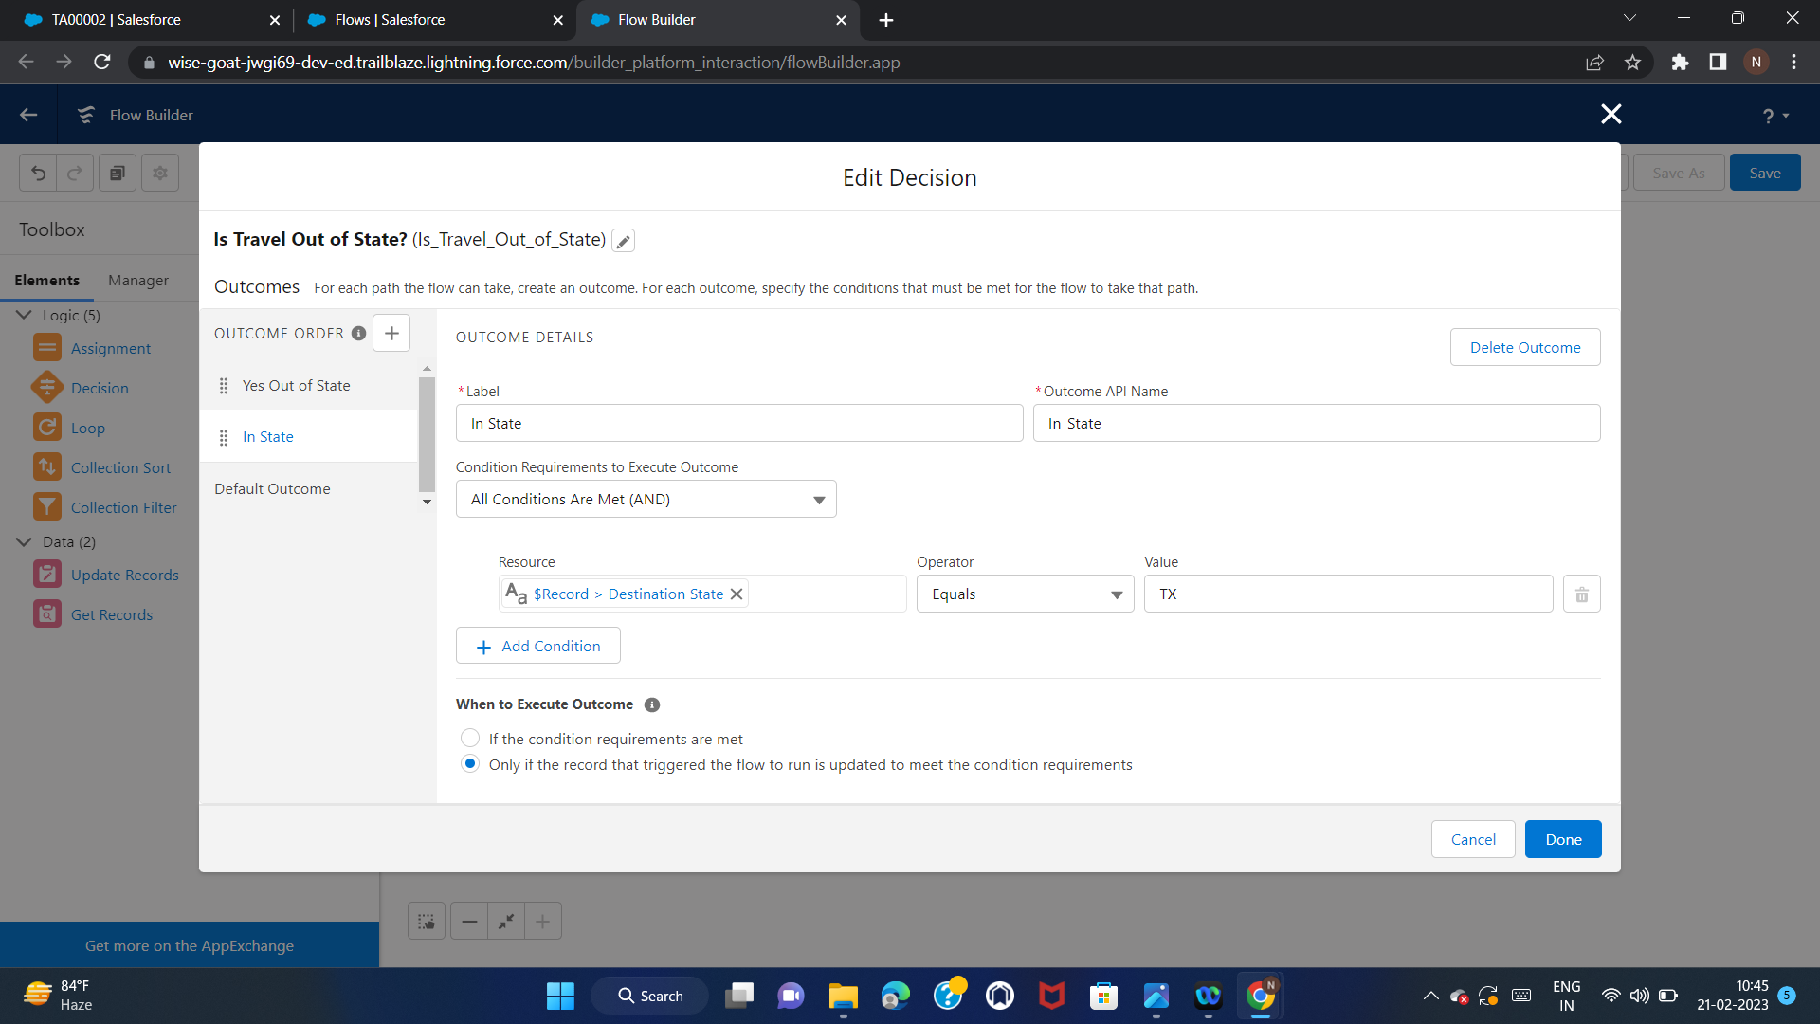
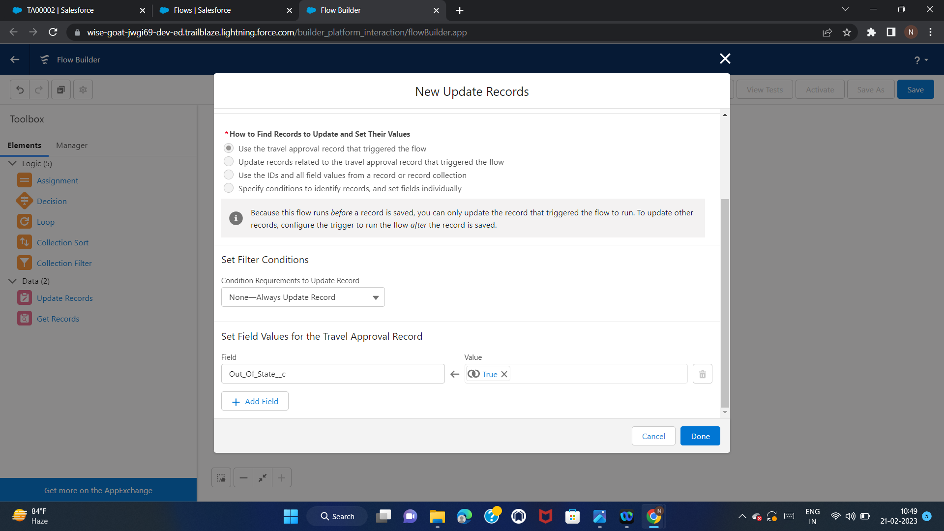
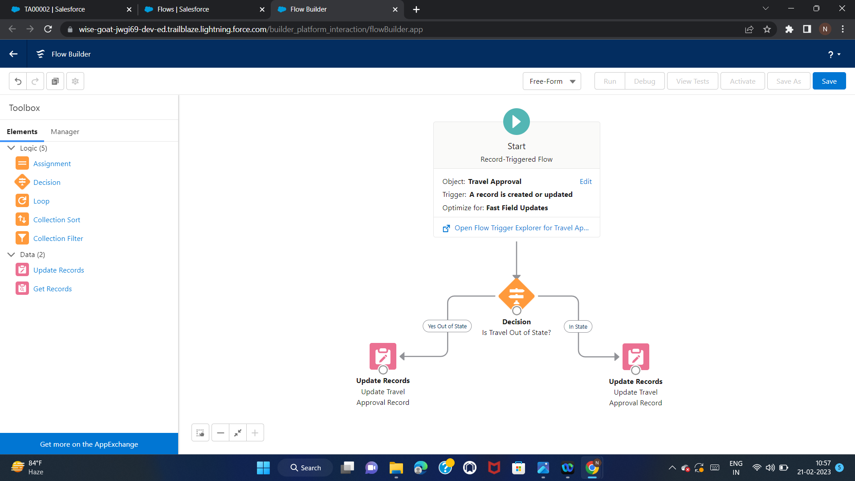

Slide 34
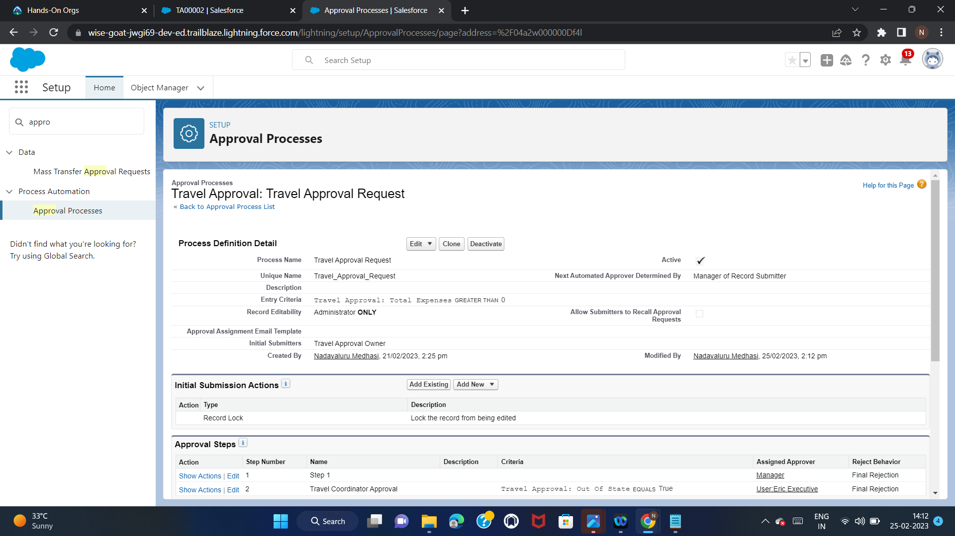
Step 6:
1.Create an Approval Process to send Travel approvals to Manager or Travel coordinator.
2.Approval Process Name: Travel Approval Request (Leave rest of the options as it is)
3.Specify Entry Criteria: Use this approval process if the following: Formula Evaluates to True.
4.In Formula space, Add “True”. There will be no Error.
5.Select Approver: Automatically assign an approver using a standard or custom hierarchy field: Manager
6.Click Save.
7.Click View Approval Process Detail Page.

Slide 35
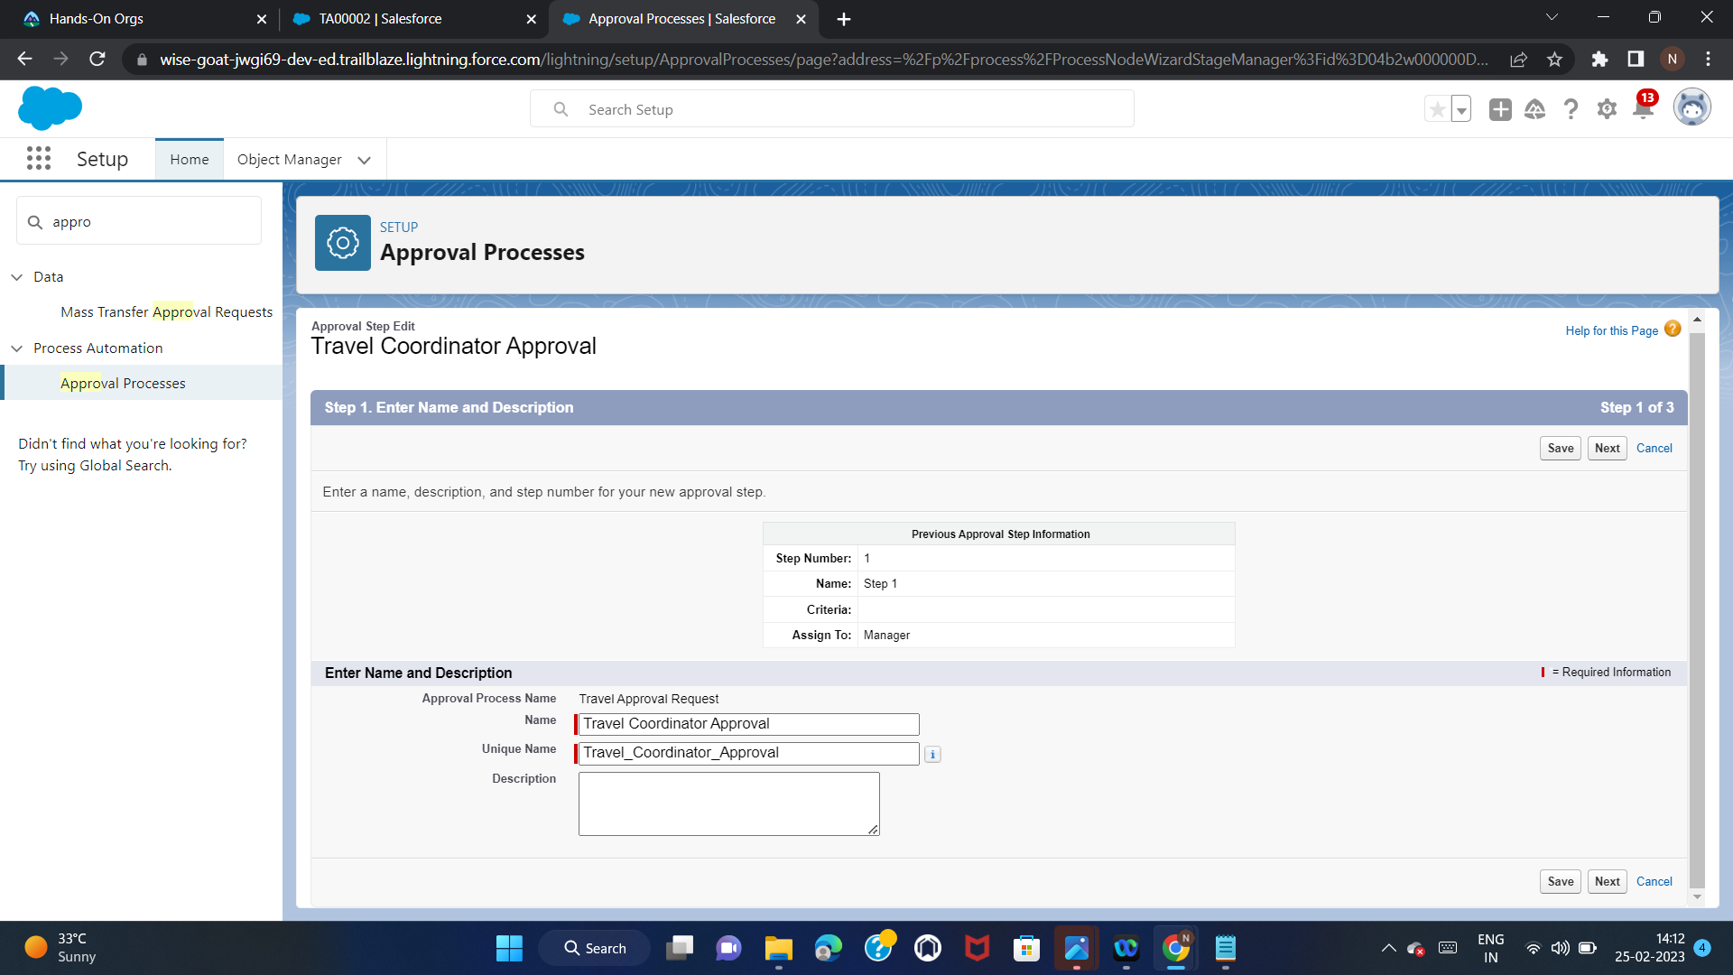
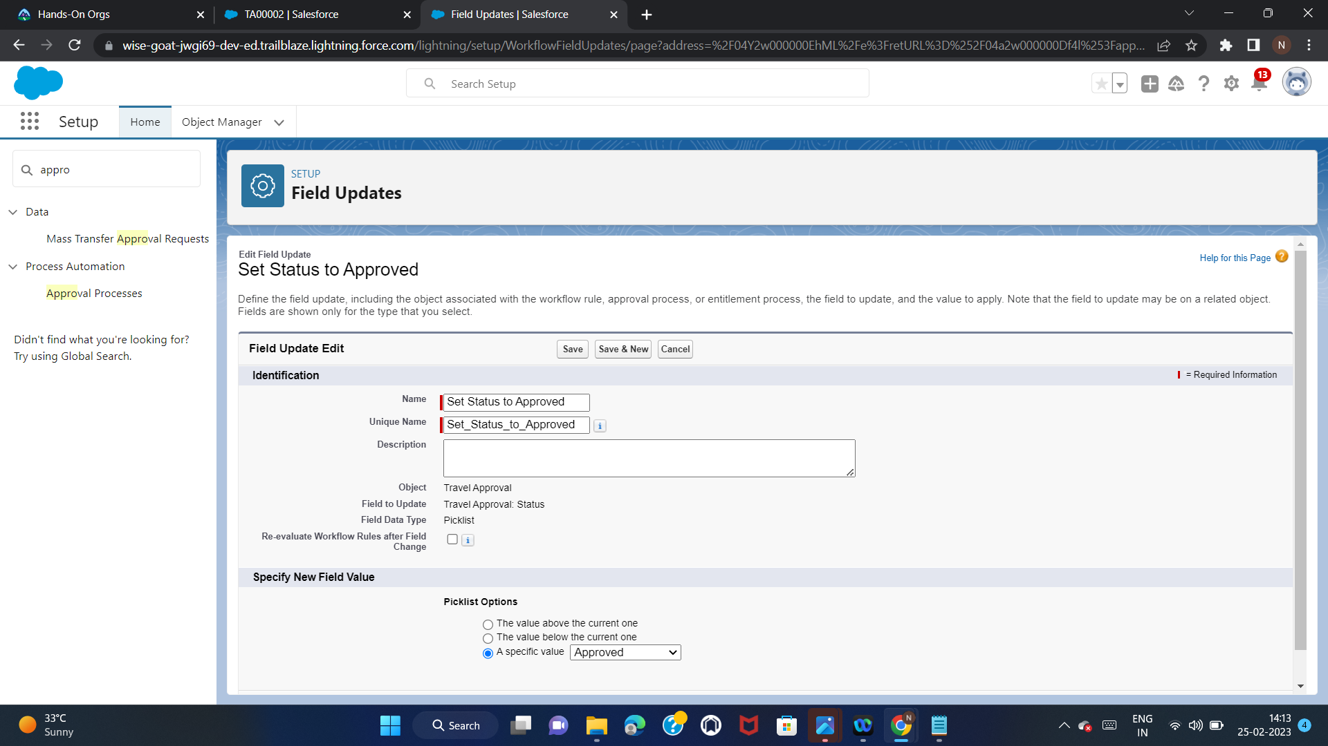
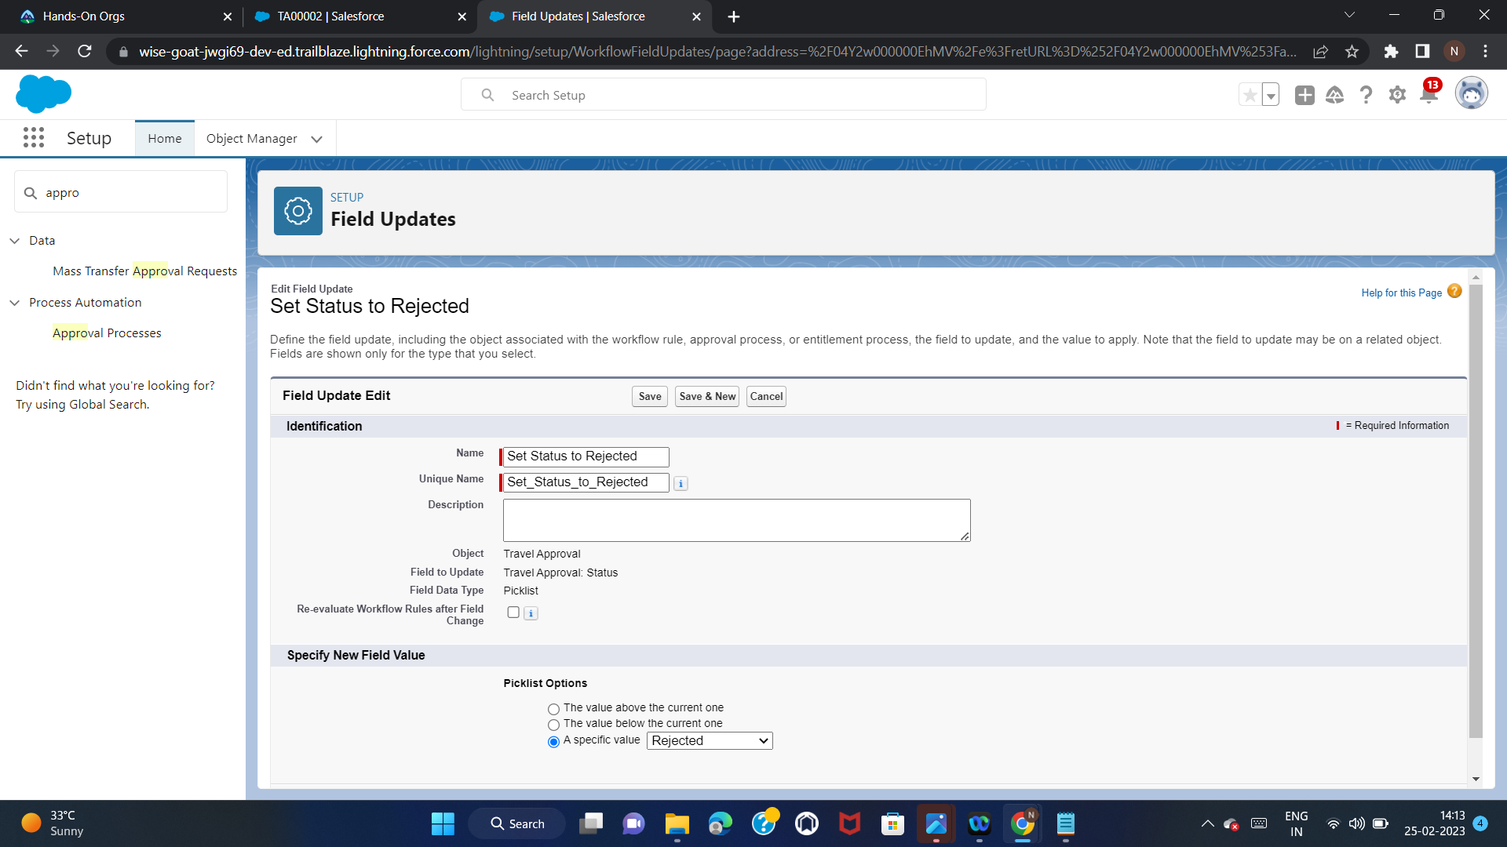
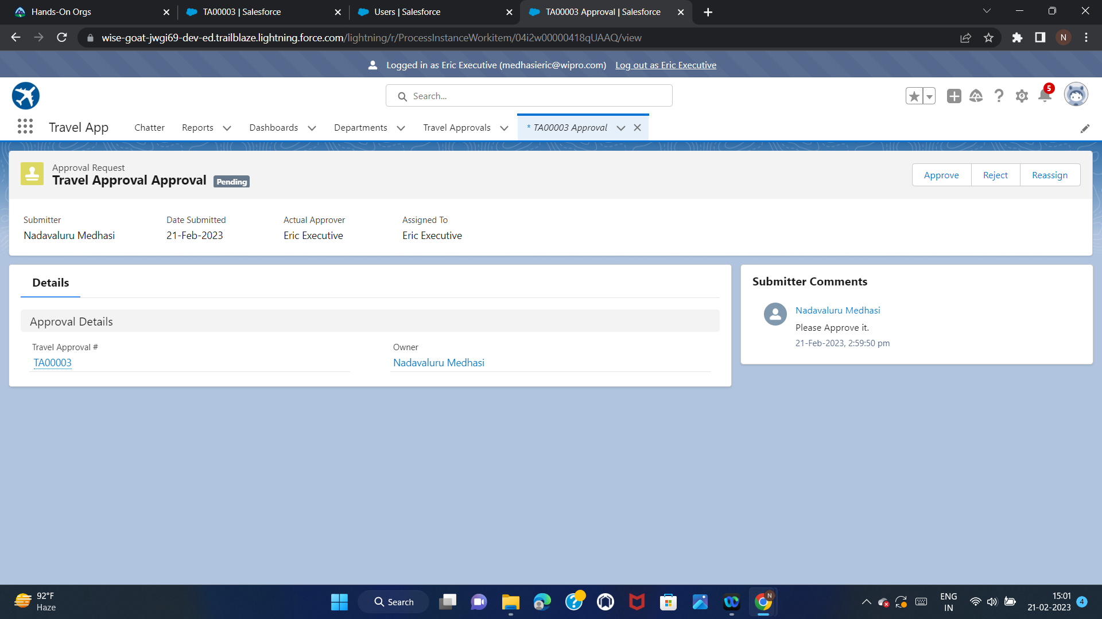

Slide 36
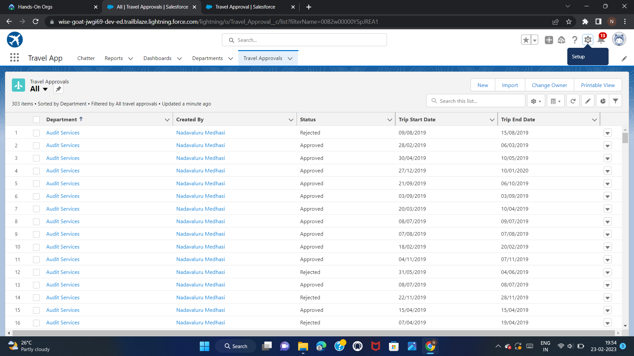
Exercise 2
Step 1:
Use Data Import Wizard to import Travel Approval records.
Open Import Wizard | Custom Object = Travel Approvals.
Add New Records
Which Department field in your file do you want to match...= Department Name
Trigger workflow rules and processes for new and updated records = Checked.
.CSV File = TravelApprovals
Edit Field Mapping: Fields should be Mapped Automatically, Next, Start Import.

Slide 37
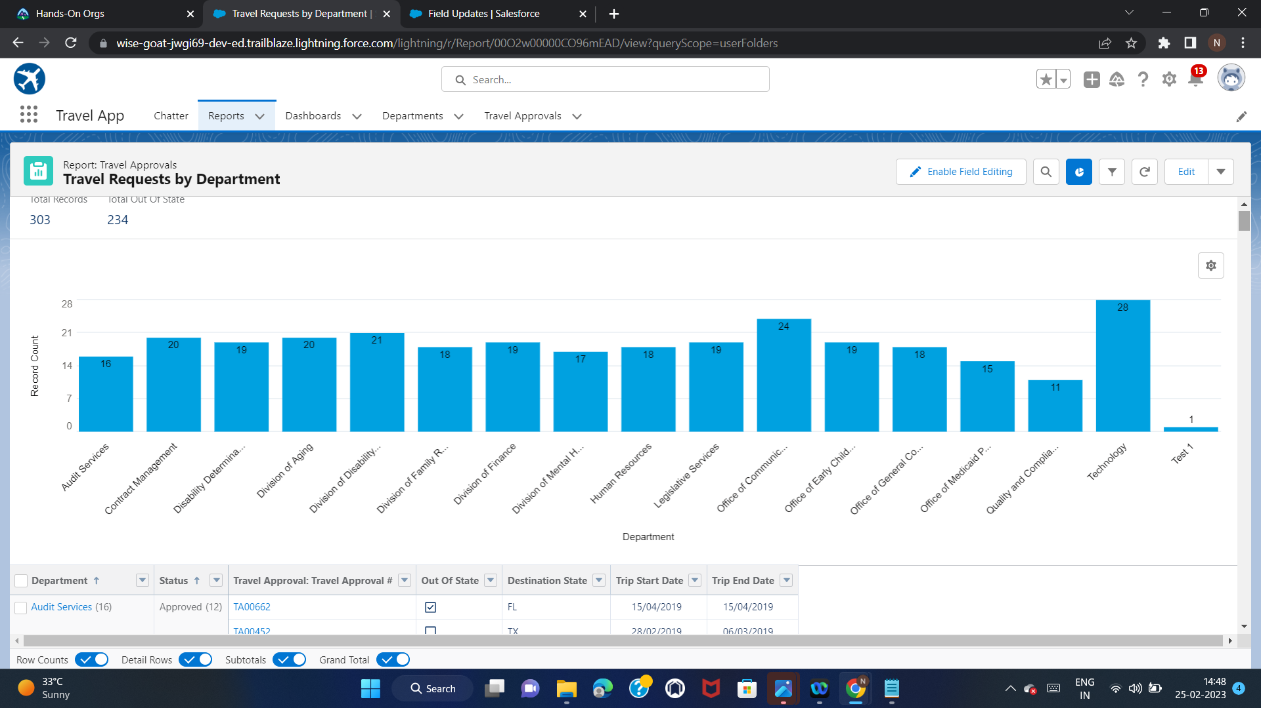
Step 2:
Create a Travel Requests by Department Report
Click on Reports Tab | Click “New Report”
Report types = Travel Approvals.
Add column:Department, Status,Out-of-State,Destination State,Trip Start/End Date
Group Rows by This Field: Department & Status
Add a Chart(Column), X Axis = Department, Y Axis = Record Count,
Show Values = Checked.
Save report as: Travel Requests by Department, Folder: Public Reports.

Slide 38
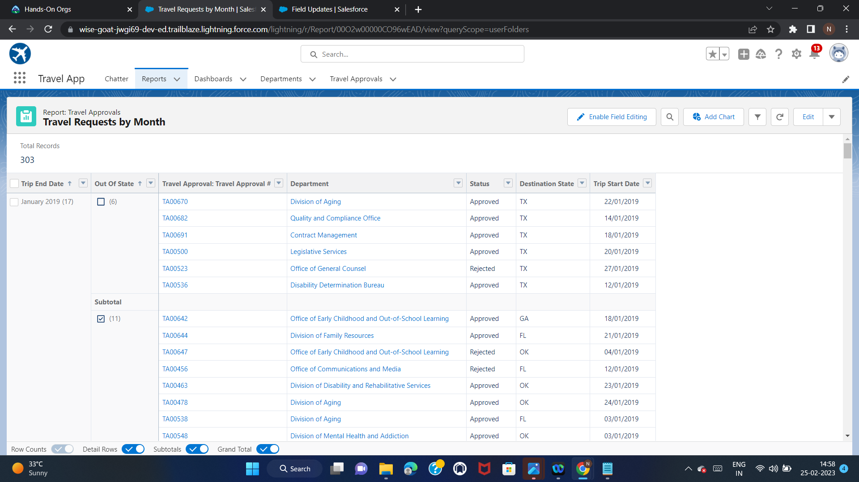
Step 3:
Create a Travel Requests by Month Report
Click on Reports Tab | Click “New Report”
Report types = Travel Approvals.
Add column:Department,Status,Out-of-State,Destination State, Trip Start/End Date
Group Rows by This Field: Trip End Date, select Group Dates By | Calendar Month.
Group Rows by This Field: Out-Of-State.
Save report as: Travel Requests by Month, Folder: Public Reports.

Slide 39
Step 4:
1.Create a Travel Approvals Dashboard
2.Click on Dashboard Tab | Click “New Dashboard”
3.Name: Travel Requests Dashboard, Folder: Private Dashboard. Click Create.
4.Click + Component, Click the Travel Request by Department report and click
Select
5.Make sure the Y-Axis is set to Department and the X-Axis is set to Record
Count. Click Add
6.Click + Component, Click the Travel Request by Month report and click Select
Display As | Stacked Vertical Bar Chart, Sort By | Trip End Date, Click Save,
click Done.

Slide 40
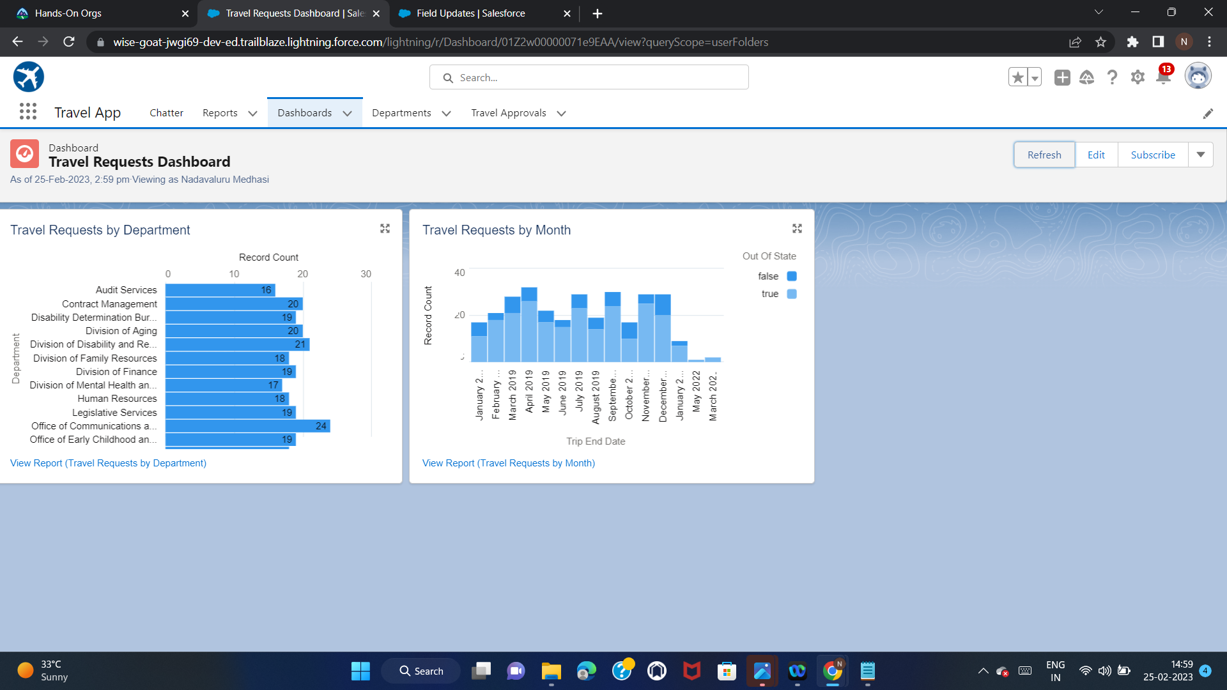

Slide 41
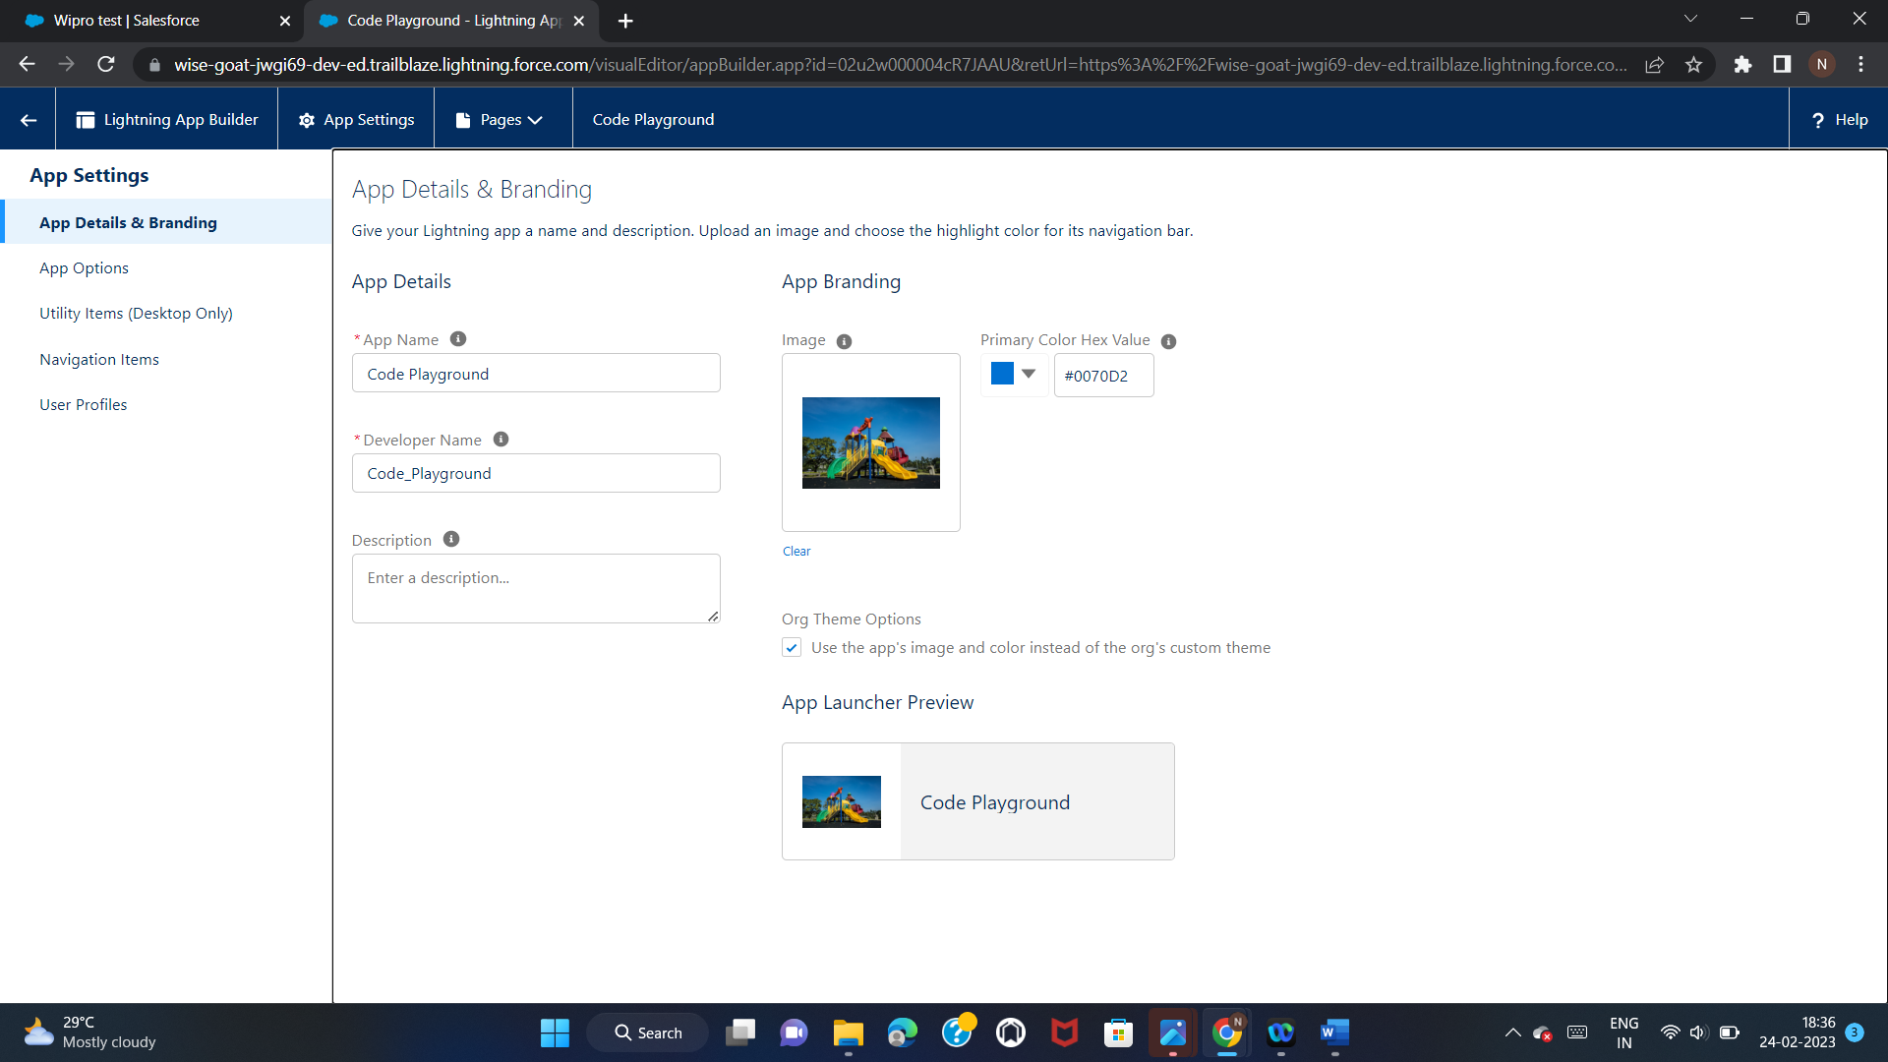
Module 3
Exercise 1:
Create a new custom lightning App, name: Code Playground.
Upload an App image, Keep “Org Theme options” checked.
Navigation Style=”Standard Navigation”,leave rest as it is.
Add Lead,Account,Contact,Opportunity,Case to the Navigation items.
User Profile=”System Administrator”
Save and Finish.

Slide 42
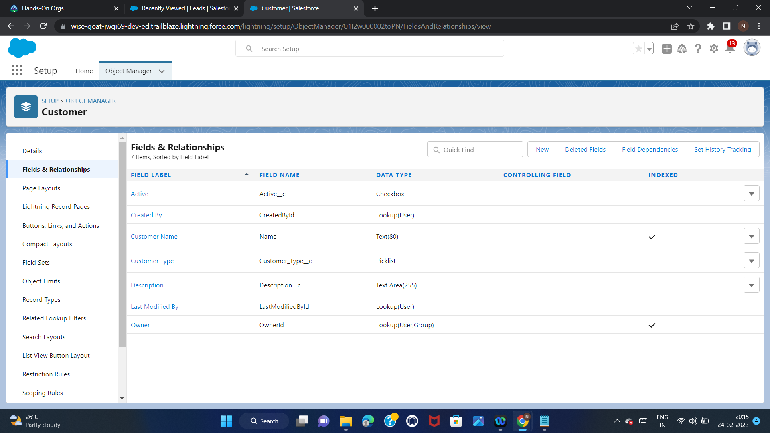
Create a Custom Object.
Label=Customer, Plural Label=Customers
Record Name=Customer Name,Data Type=Text
Allow Report,Allow Search
Create a New Custom Tab
Create a Custom fields for Customer Object.
Label=Active,Checkbox,Save
Label=Customer Type,Picklist Values: Premium,Standard
Label=Description,Text Area,Save

Slide 43
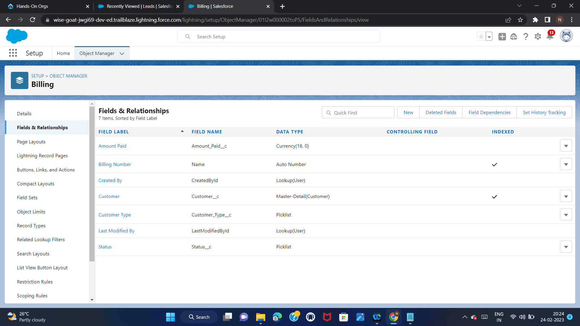
Create a Custom Object
Label=Billing,Plural Label=Billings
Record Name=Bill Number
Type=Auto Number,Format=B-{0000},Starting number 1
Allow Report,Allow Search
Create a New Custom Tab
Add it to “Code Playground” App only,Save
Create a custom fields for Billing Object
Label=Amount Paid,Currency,Save
Label=Customer Type,Picklist,Values: Premium,Standard
Label=Status,Picklist,Values:Paid,Unpaid
Label=Customer,Master-Detail,Related To - Customer custom object

Slide 44
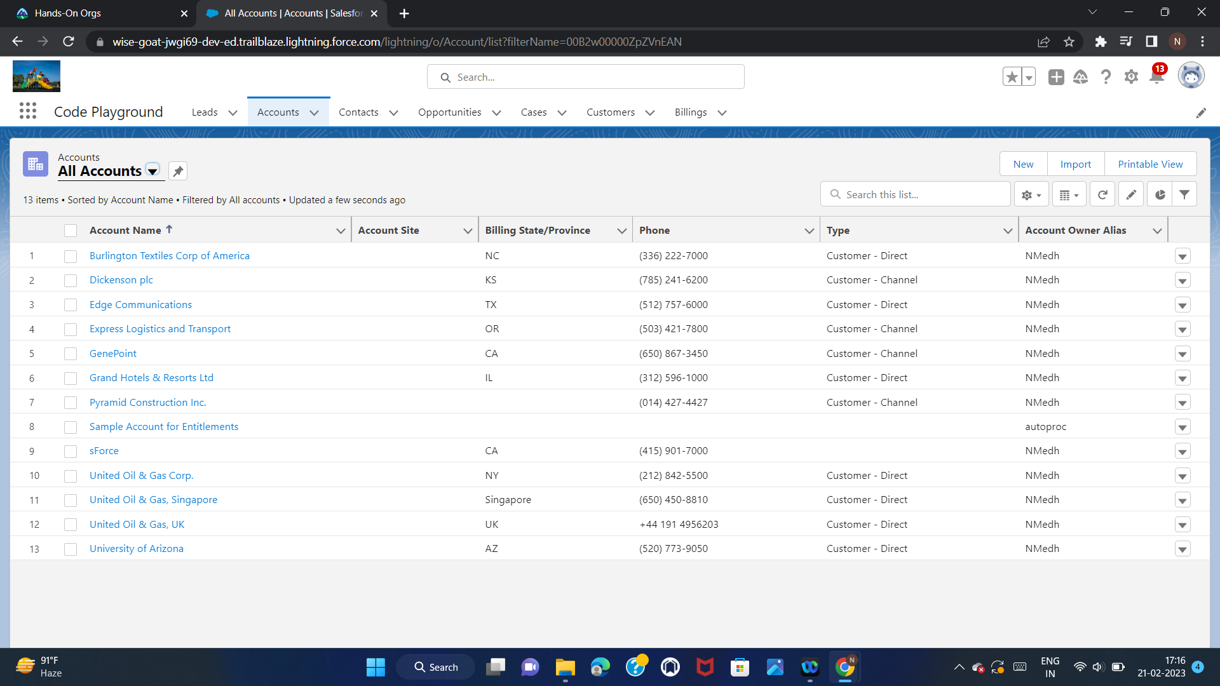

Slide 45
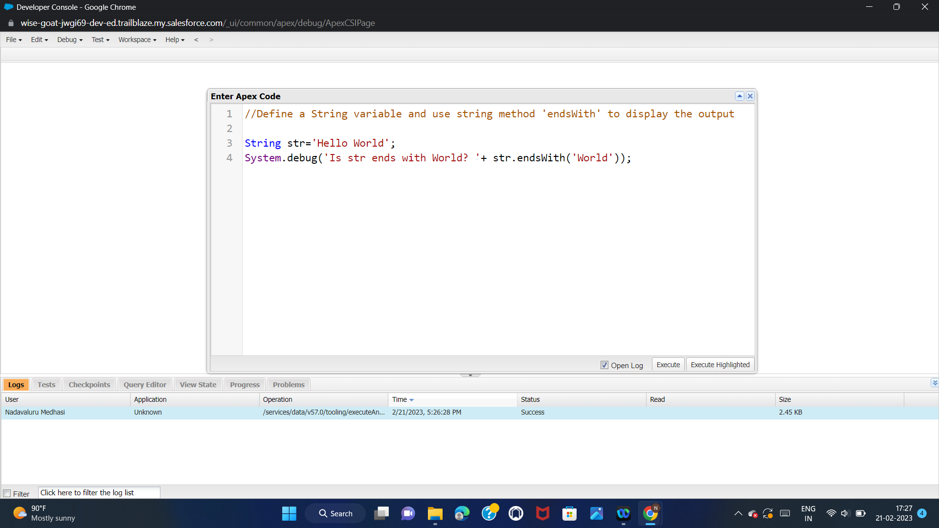
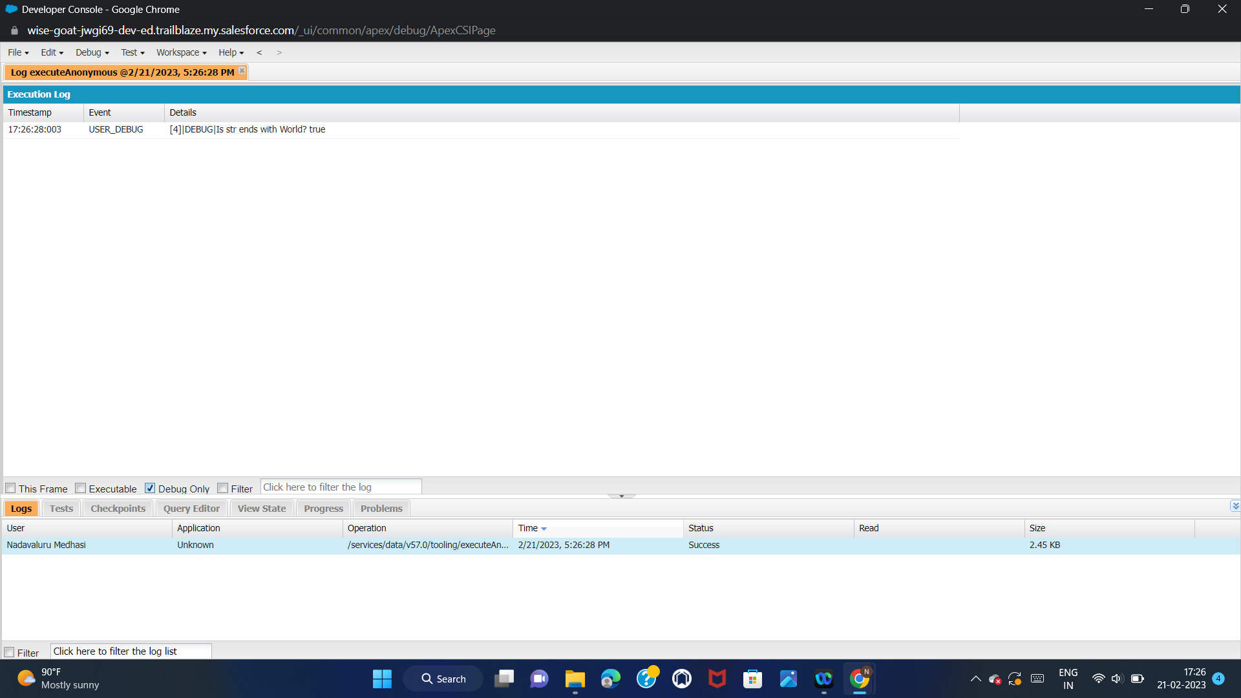
Exercise 2:
Use Execute Anonymous to define and execute the following code:
Define a String and use string method ‘endsWith’ to display the output

Slide 46
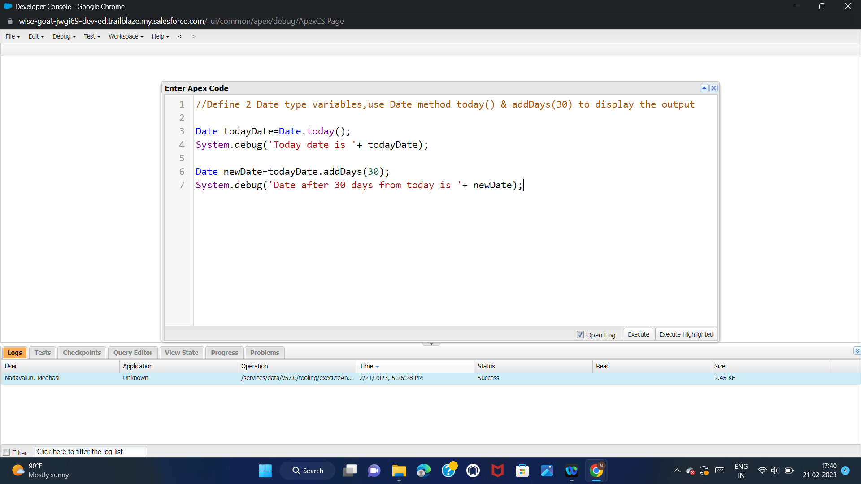
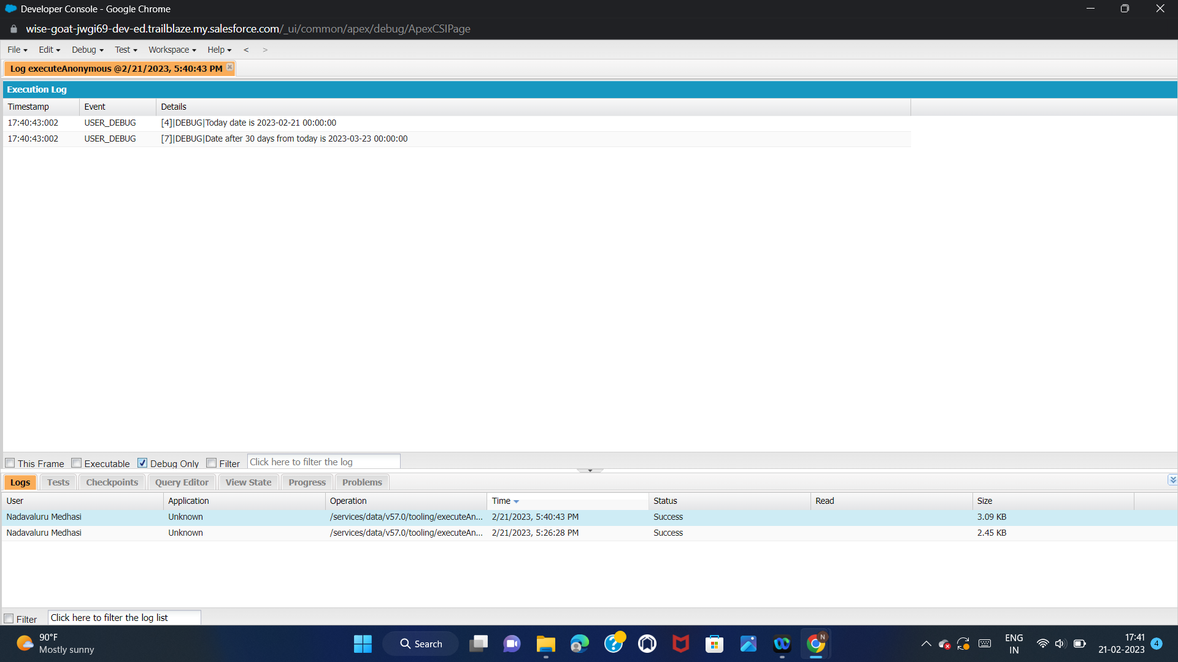
Define 2 Date type variables,use Date method today() and addDays(30) to display the output

Slide 47
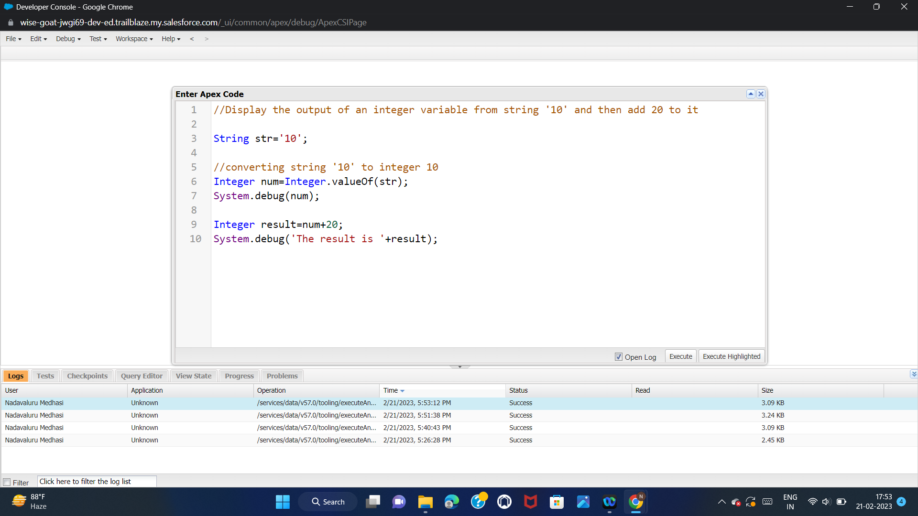
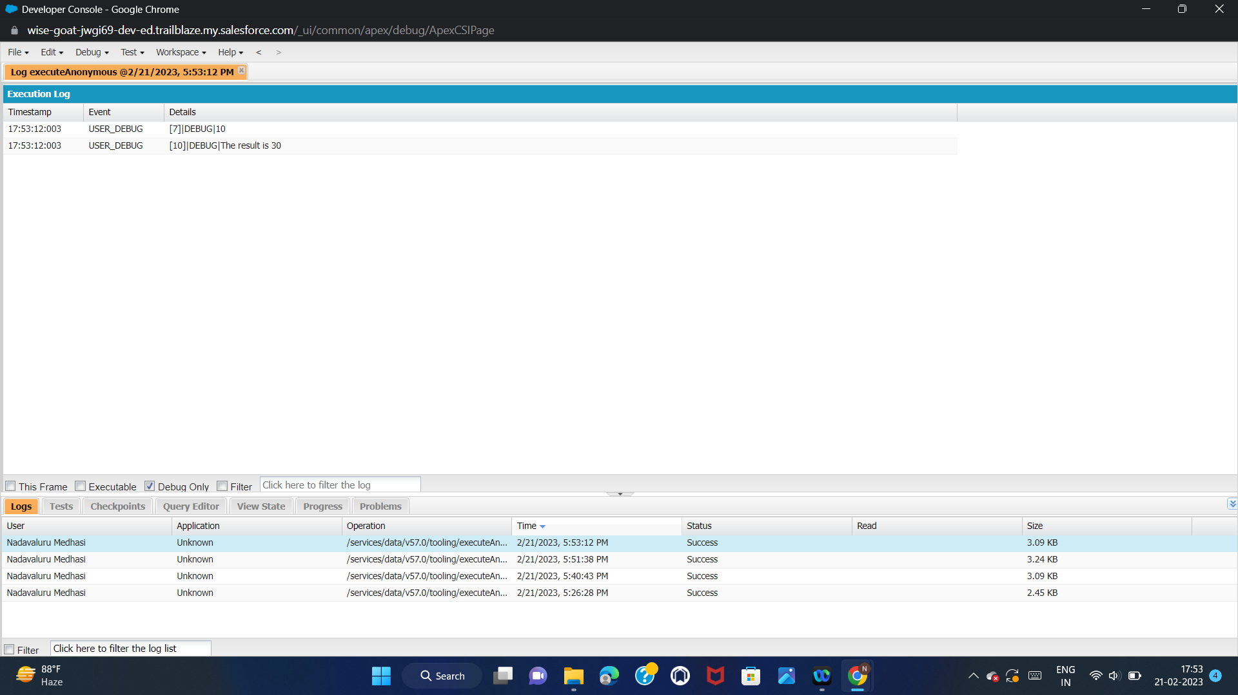
Display the output of an integer variable from string ‘10’ and then add 20 to it

Slide 48
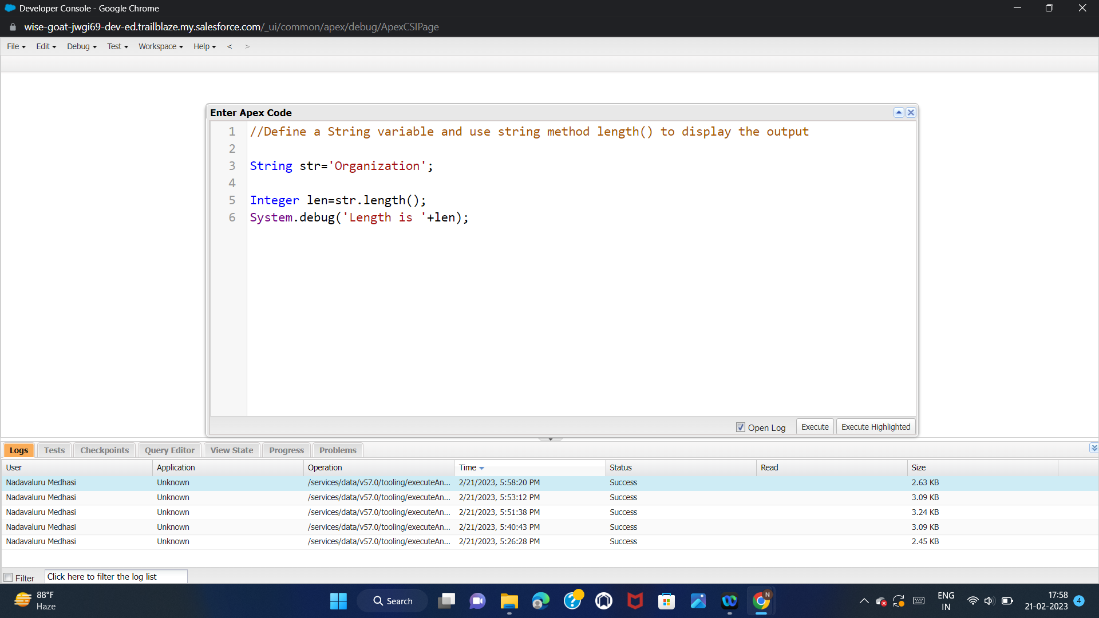
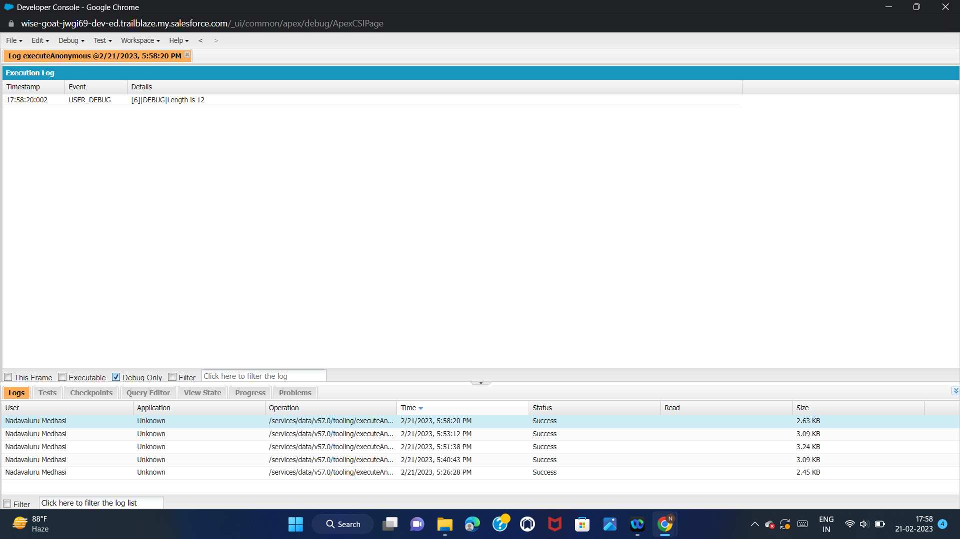
Define a String variable & use string method length() to display the output

Slide 49
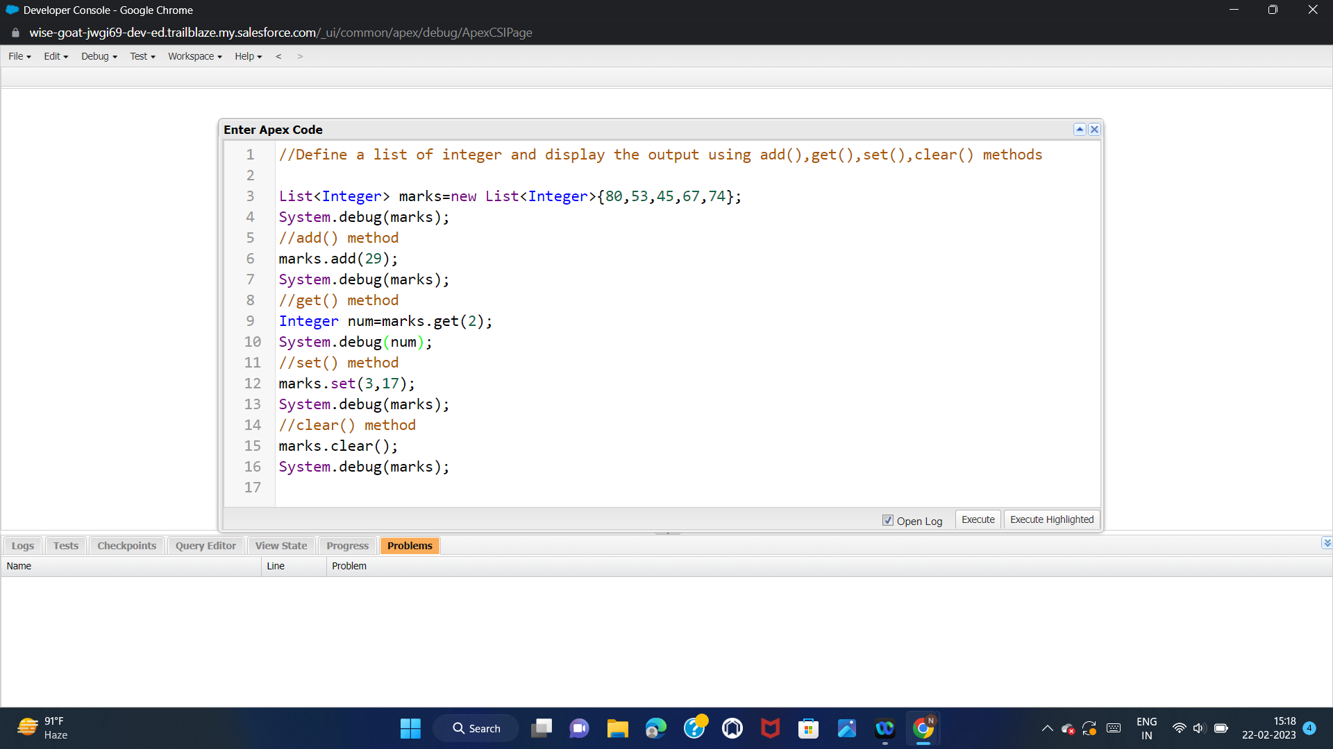

Define a List of integer and display the output using add(),get(),set(),clear() methods

Slide 50

Use Execute Anonymous to define and execute the following code to display the value of x=0 to 9
Integer x=20
while(x>12){define the code}
for(Integer x=?;x<10;x=x+1)
{
System.debug(‘Value of x is: ‘+x);
}

Slide 51


Exercise 3:
Answer the following in True or False:
Integer myluckyNumber=15;
Integer myunluckyNumber=7;
myluckyNumber != myunluckyNumber

Slide 52


Exercise 4:
Answer the following in True or False:
Boolean isTrue=True;
Boolean isFalse=false;
isTrue || isFalse

Slide 53


Exercise 5:
Answer the following in True or False:
Date today=Date.today();
Date tomorrow=Date.today().addDays(1);
today != tomorrow

Slide 54

Exercise 6:
Write a program and execute to demo the use of “If..else if...else”
Define an Integer variable called Score.
System.debug (‘Grade: A+’), if Score is equal to 100.
System.debug (‘Grade: A’), if Score is greater than or equals to 90.
System.debug (‘Grade: B’), if Score is greater than or equals to 80.
System.debug (‘Grade: Failed’), define as final else.

Slide 55
Exercise 7:
Write a program to execute and demo the use of “Apex – for Loop”
Initialize the Billing object list to store the Billing Records created today, use SOQL.
Use for Loop to iterate over the list and check if the Billings status = Paid.
System.debug (‘Value of Current Record in the Loop’+ Billing List);
if Status is paid then add the Billings into a List of String.
System.debug('Value of BillingList '+BillingList);
Note: Create at least 2 Billing records with Status = Paid for this exercise.

Slide 56



Slide 57


Exercise 8:
Write a Class to demo the use of Constants in Apex
Class Name = DiscountClass.
Define a Final Decimal variable called “regularDiscount”.
Define a Decimal variable called “finalPrice”.
Define a Method called “calculateDiscount(Integer price)”, takes a Decimal data type.
finalPrice = price - price*regularDiscount;
Don’t forget to return a Decimal data type.

Slide 58
Exercise 9:
Write a Class to demo the use of Interface in Apex
Interface Class Name = InterfaceExample.
Method Signature = Double percentageDiscountTobeApplied();
Create an Apex Class to implement the Interface Class, Name = PremiumCustomer
Call the interface method to return 30% Discount.
Create another Apex Class to implement the Interface Class, Name = normalCustomer
Call the interface method to return 10% Discount.

Slide 59



Slide 60



Slide 61
Exercise 10:
Demo on DML Insert Operation Using Database methods
Insert a Customer Record First using simple DML Statement.
Customer Name = “Wipro”, Type = “Premium”.
Insert Billing record using Database methods.
Billing Status = Paid, Amount Paid = 5000000, link Billing record to Customer using the customer ID.
Use a List<Billing c> to perform the Database insert method & store the result in srList.
Iterate through the Success/Error result, show inserted record ID, or the error message with fields.

Slide 62



Slide 63

Exercise 11:
Write and execute SOQL queries from Developer Console
Display ID, Amount, Stage, Account Name, Account Industry, Account Website From Opportunity
Add a Where Clause “Account Industry = Energy”
AND “Account Annual Revenue > 5000”

Slide 64


Exercise 12:
Write an Apex Trigger, Name = CustomerTrigger.
Create a Billing Record when on Customer Object the 'Status' field changes to Active from Inactive.
Billing “Status” must be: Paid, Amount Paid = 1000000
Perform the DML on a List.

Slide 65


Exercise 13:
Write a Test Class for CustomerTrigger.
Create the Data for the Customer custom Object
Use Test.startTest() & Test.stopTest().
Use assert statement to validate the output, Test Class must have full code
coverage.

Slide 66


Exercise 14:
Write an Apex Trigger, Name = DisqualifyTestLeads.
Define logic to find Leads with ‘Test’ in the Name, Ignore Case.
Validate that the Lead First/Last Name must not be Blank.
IF ‘Test Lead’ found, system.debug(Lead First Name + ‘ ’ + Lead Last Name + ‘Will be disqualified!’);
Add the disqualified Leads to a List<Lead>, use for loop to iterate through the list and update Lead status field to ‘Disqualified’.

Slide 67


Exercise 15:
Write a Test Class for DisqualifyTestLeads.
Create the Data for the Lead Object
Use Test.startTest() & Test.stopTest().
Use assert statement to validate the output, Test Class must have full code
Coverage.

Slide 68

Exercise 16:
Create a Visualforce page which displays Opportunity fields as output fields.
The page must be named OppView, It must reference the Opportunity standard
controller.
Define 4 apex:outputField components:
Opportunity Name, Amount, Close Date, Opportunity Account Name.

Slide 69
Exercise 17:
Create a Visualforce page which shows a list of Accounts linked to their record pages.
The page must be named AccountList
It must reference the Account standard controller.
It must have a recordSetVar attribute equal to accounts
It must have a Visualforce apex:repeat component, with the following:
Use the var attribute set to “a”, Use the <li> HTML list tag
Use the apex:outputLink component to link to the respective record detail page

Slide 70

Exercise 18:
Create a Visualforce page that uses a custom controller to display a list of cases with the status of 'New'. The page must be named NewCaseList.
The custom controller Apex class must be named NewCaseListController and include the following:
A publicly scoped method named getNewCases | Use the return type of List<Case>
Return a list of case records that includes the ID
and CaseNumber fields.
Filter the results returned to only have a status of New.
The NewCaseList Visualforce page must use an apex:repeat component, which is: Bound to newCases, Refers to the var attribute as case, bind an apex:outputLink component to the ID of the case.

